Slide 1
Quantitative Risk Management Application
Gilles Criton
2020

Slide 2
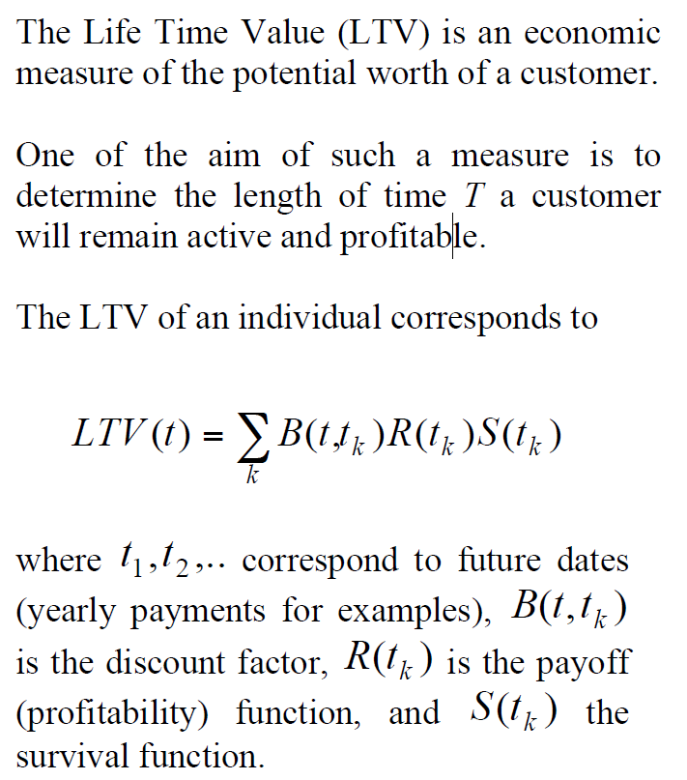
Life time value

Slide 3
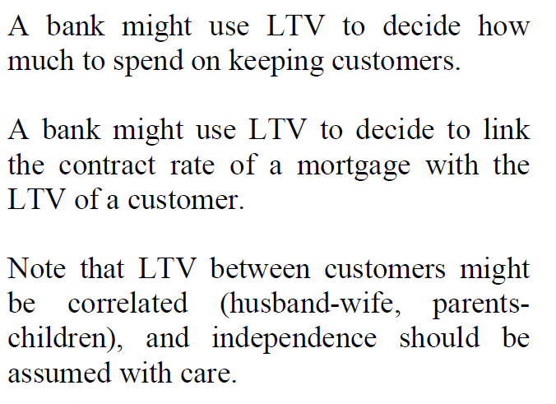
Life time value

Slide 4
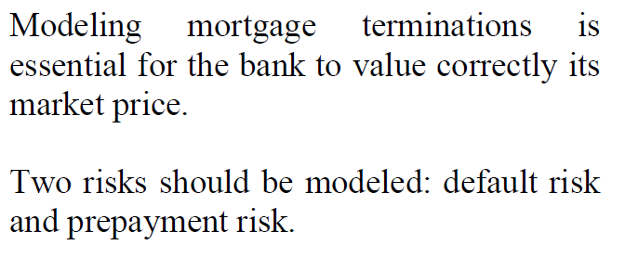
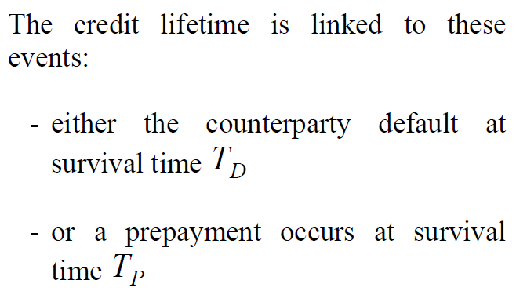
Default, prepayment and credit lifetime

Slide 5
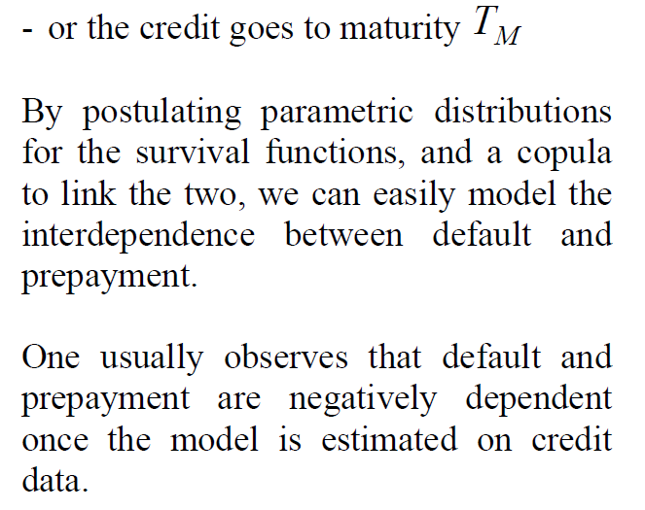
Default, prepayment and credit lifetime

Slide 6
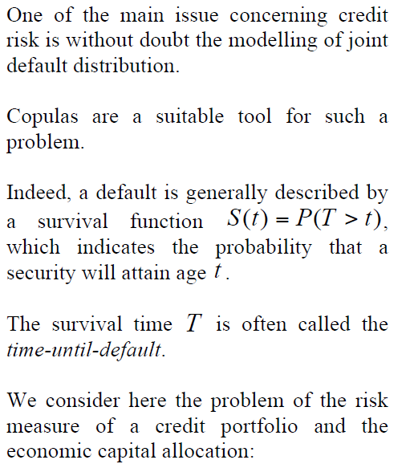
Measuring the risk of credit portfolios

Slide 7
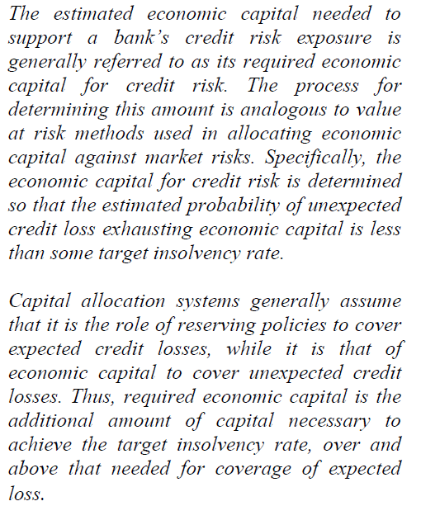
Quote from Basel Committee on Banking Supervision

Slide 8
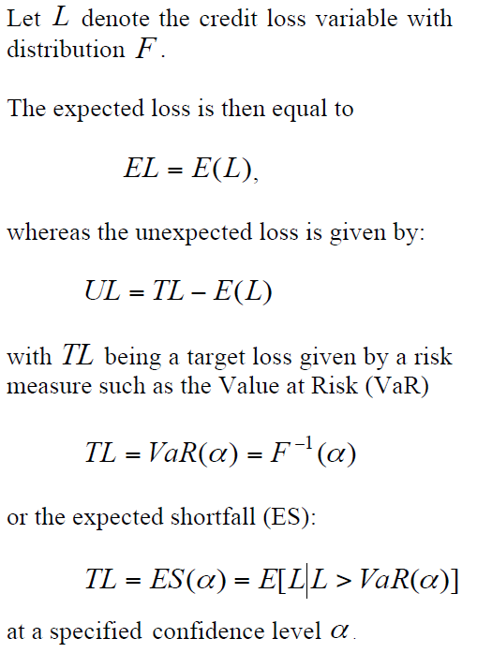
Measuring the risk of credit portfolios

Slide 9
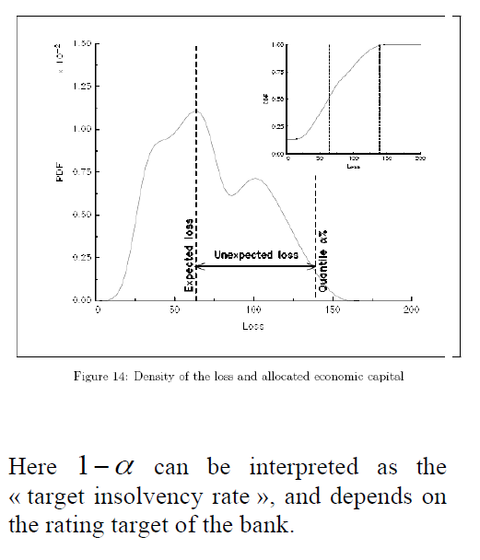
Measuring the risk of credit portfolios

Slide 10
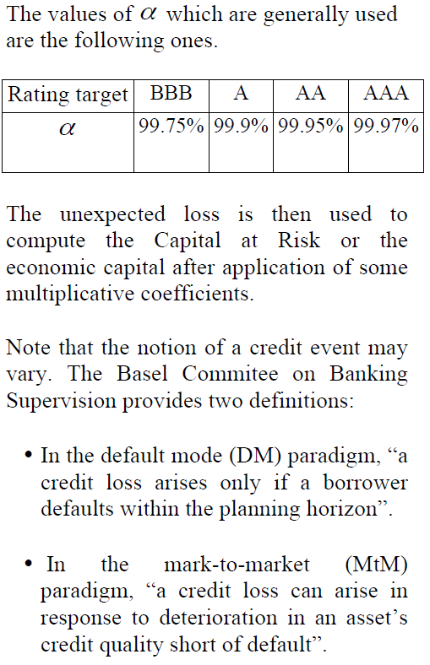
Measuring the risk of credit portfolios

Slide 11
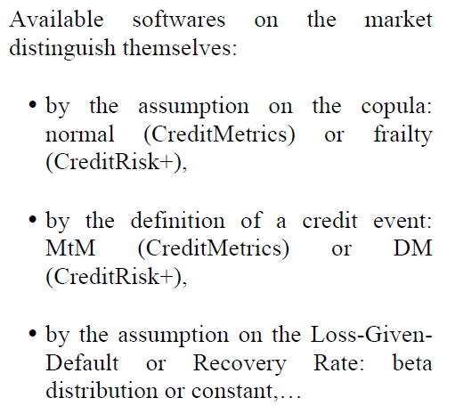
Measuring the risk of credit portfolios

Slide 12
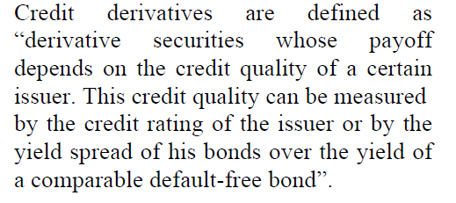
Pricing Credit Derivatives

Slide 13
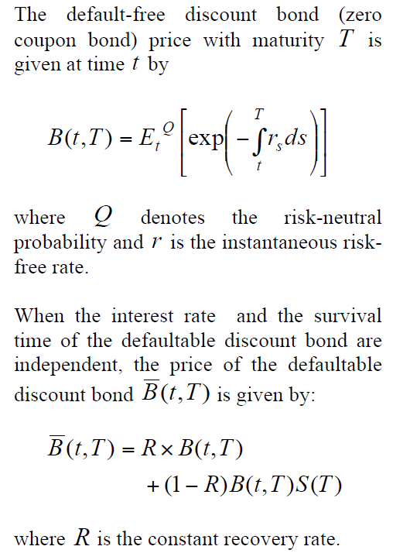
Pricing Credit Derivatives

Slide 14
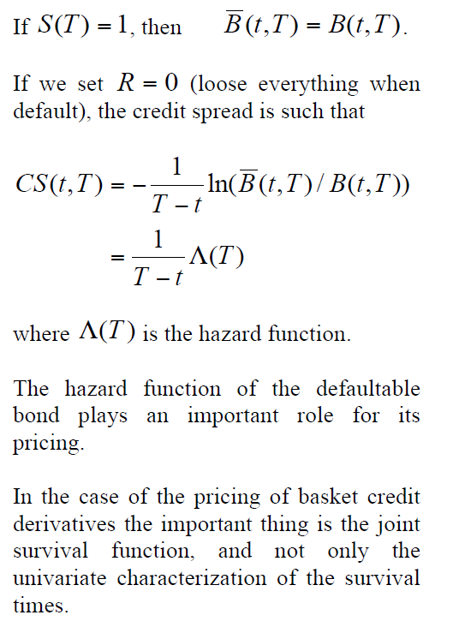
Pricing Credit Derivatives

Slide 15
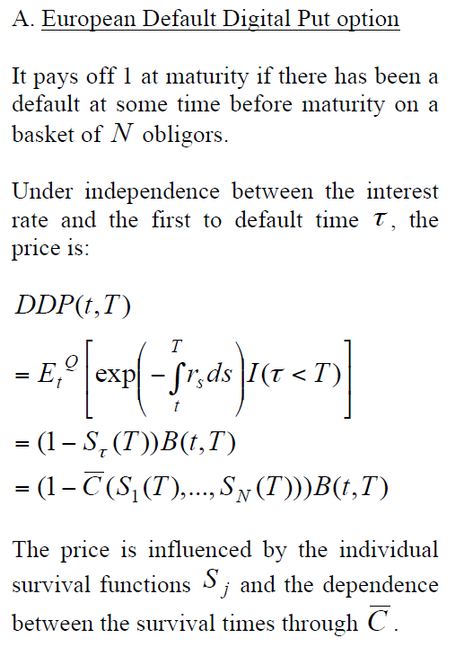
Pricing Credit Derivatives

Slide 16
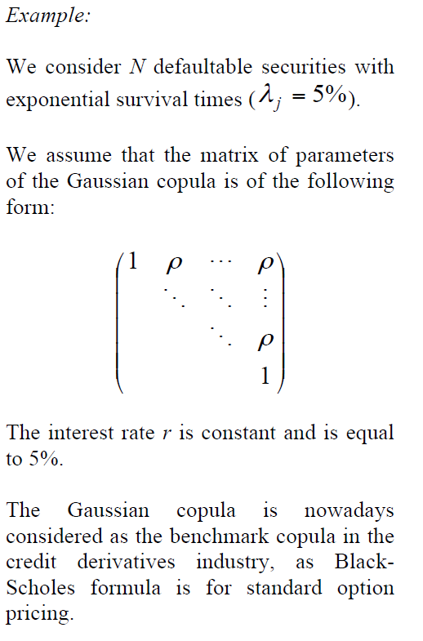
Pricing Credit Derivatives

Slide 17
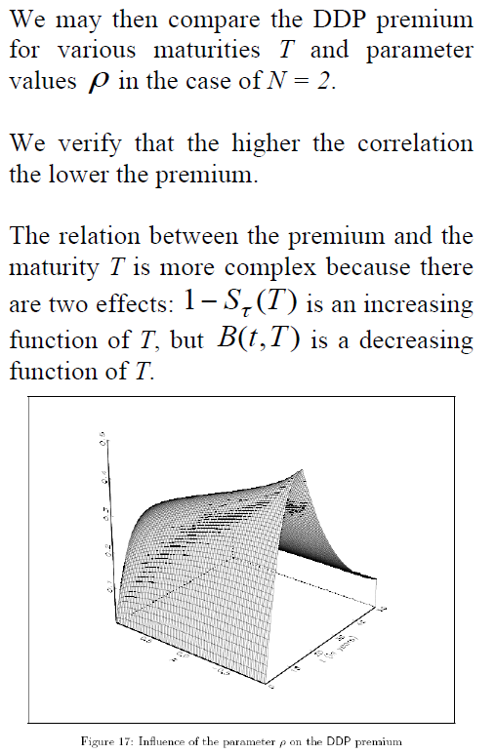
Pricing Credit Derivatives

Slide 18
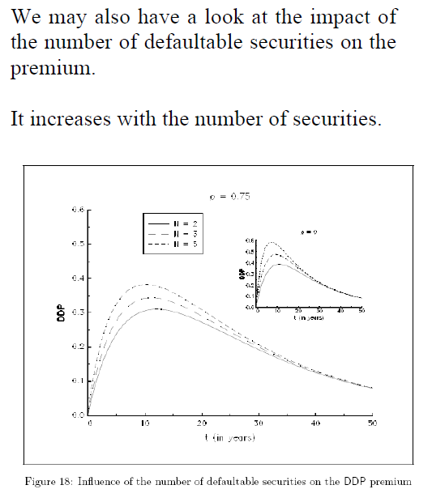
Pricing Credit Derivatives

Slide 19
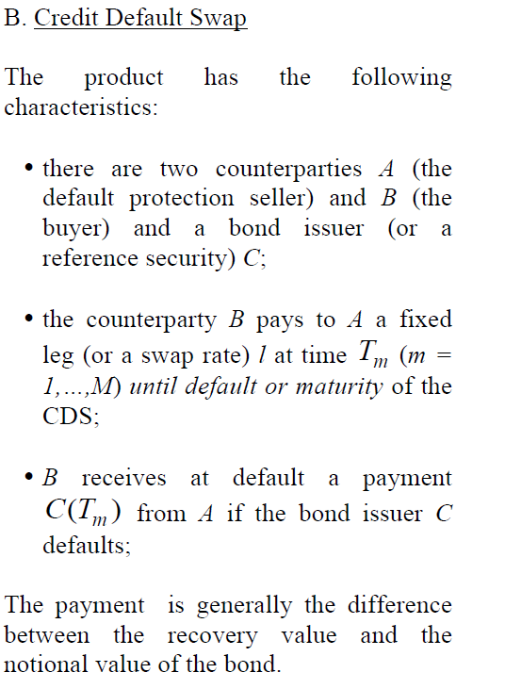
Pricing Credit Derivatives

Slide 20
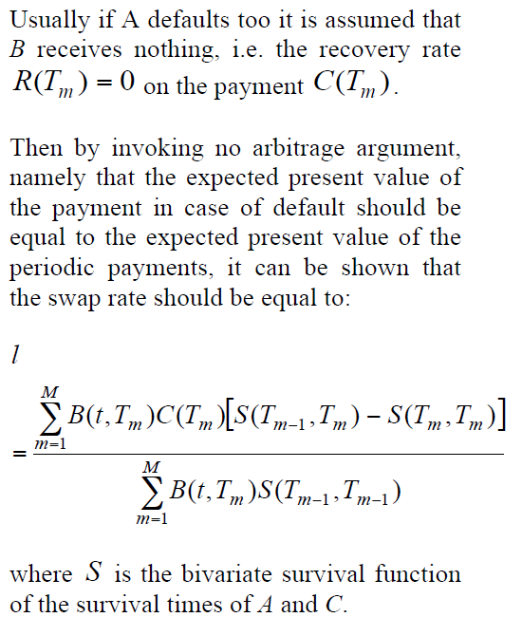
Pricing Credit Derivatives

Slide 21
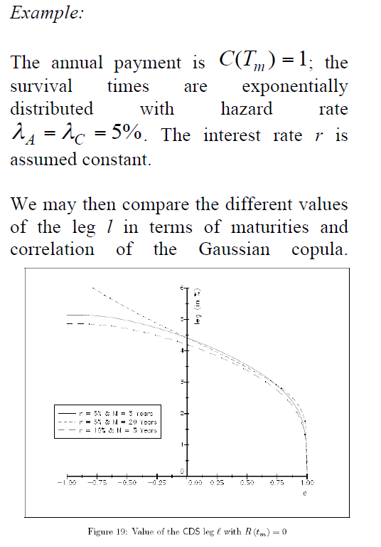
Pricing Credit Derivatives

Slide 22
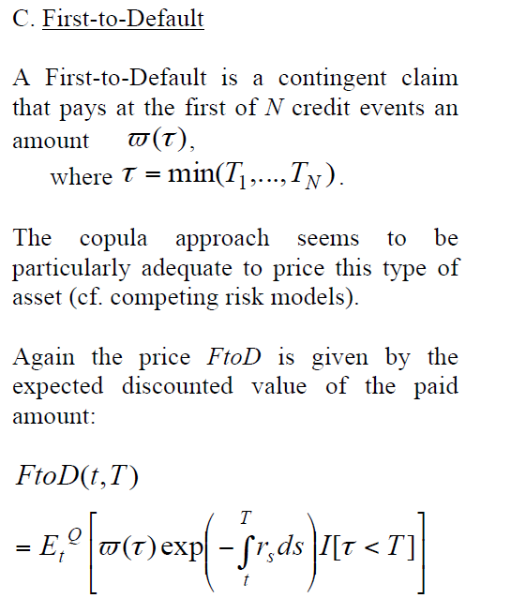
Pricing Credit Derivatives

Slide 23
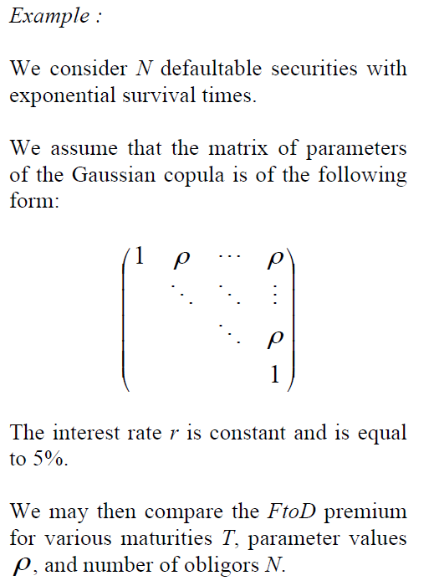
Pricing Credit Derivatives

Slide 24
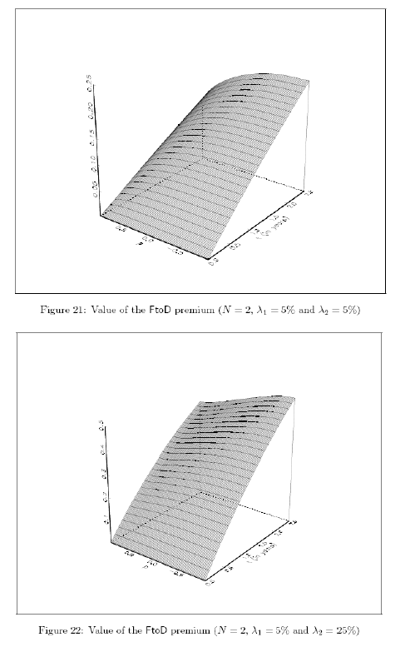
Pricing Credit Derivatives

Slide 25
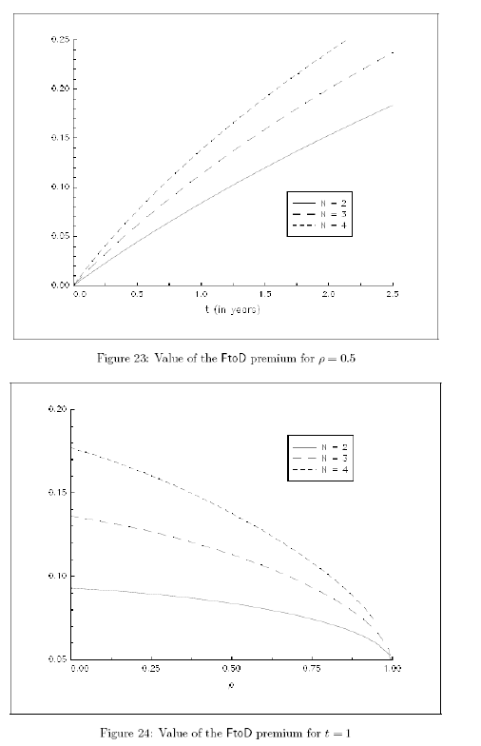
Pricing Credit Derivatives

Slide 26
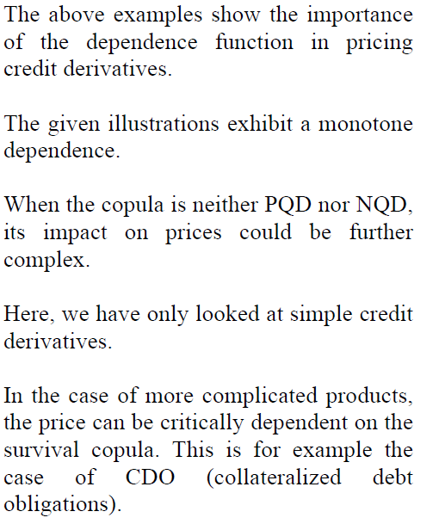
Conclusions

