Slide 1
Quantitative Risk Management SURVIVAL COPULA
Gilles Criton
2020

Slide 2
Survival Analysis
Survival analysis is a branch of statistics for analyzing the expected duration of time until one or more events happen
What makes Survival Analysis different from other fields of statistics are censoring and truncation.

Slide 3
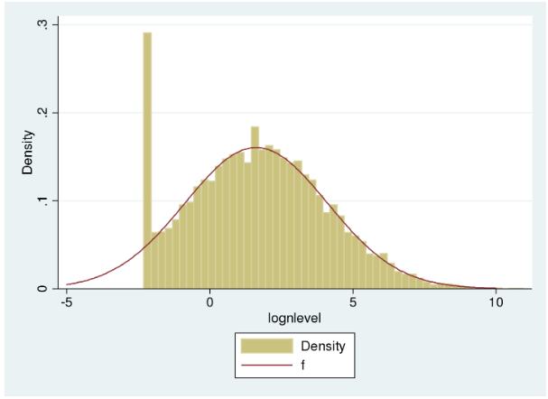
Survival Analysis Censored Data
The data were censored as opposed to truncated. When the nicotine level fell below the detection limit, the observation was still included in the sample with the nicotine level recorded as being equal to that limit.
Source: https://blog.stata.com/2016/12/13/understanding-truncation-and-censoring/

Slide 4
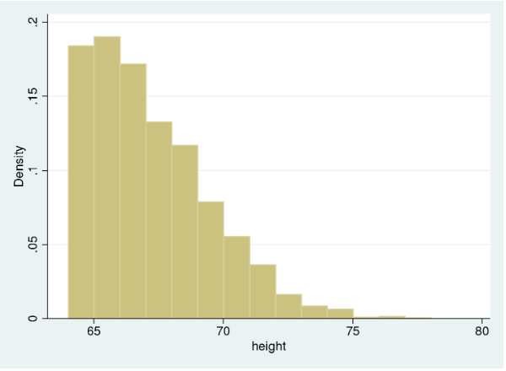
Survival Analysis Truncated Data
The data are truncated (as opposed to censored) because individuals with heights below the minimum allowed height do not appear in the sample at all.
Source: https://blog.stata.com/2016/12/13/understanding-truncation-and-censoring/

Slide 5
Survival Analysis A Short Review
Let T be a positive valued random variable.
We assume T to be continuous
Let T be the time to death of a subject
The cumulative distribution function of T
$$F\left(t\right)=P\left[T≤t\right], t≥0$$
May be interpreted as the probability that a randomly selected subject from the population will die before time t.
Since we have assumed T to be a continuous random variable, it has a pdf which is given as
$$f\left(t\right)=\frac{dF(t)}{dt}.$$

Slide 6
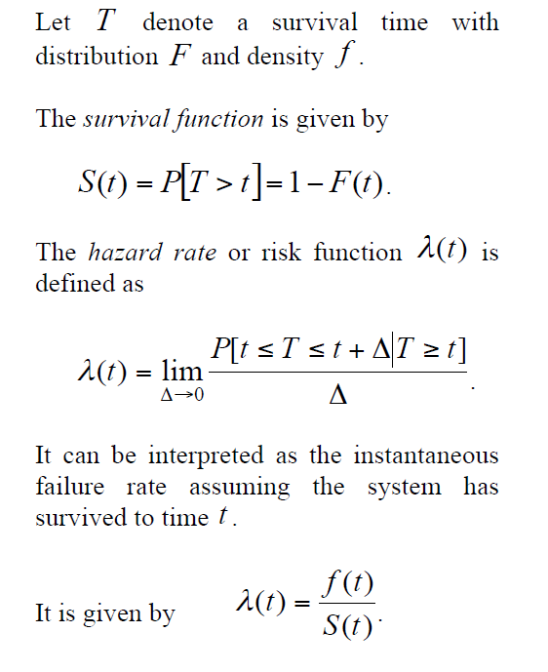
Univariate survival notions

Slide 7
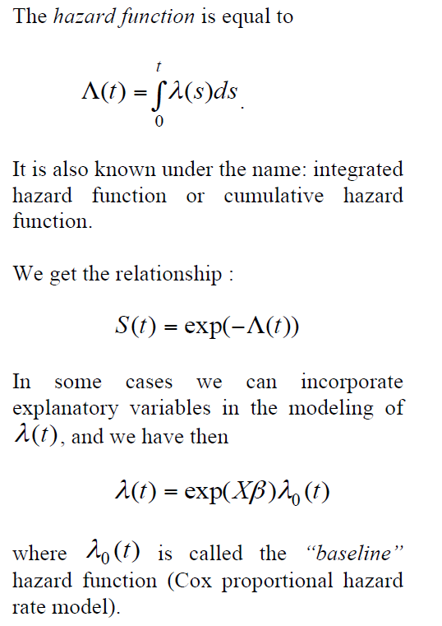
Univariate survival notions

Slide 8
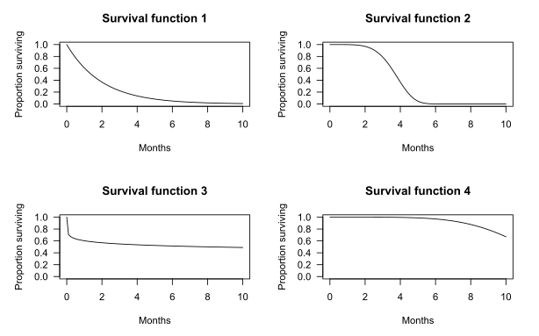
Examples of survival functions
Source: Wikipedia

Slide 9
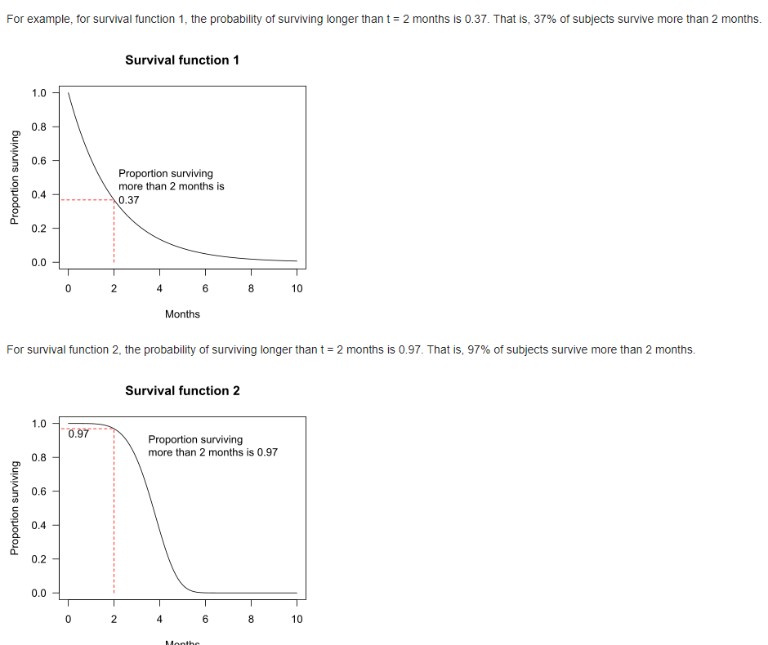
Examples of survival functions
Source: Wikipedia

Slide 10
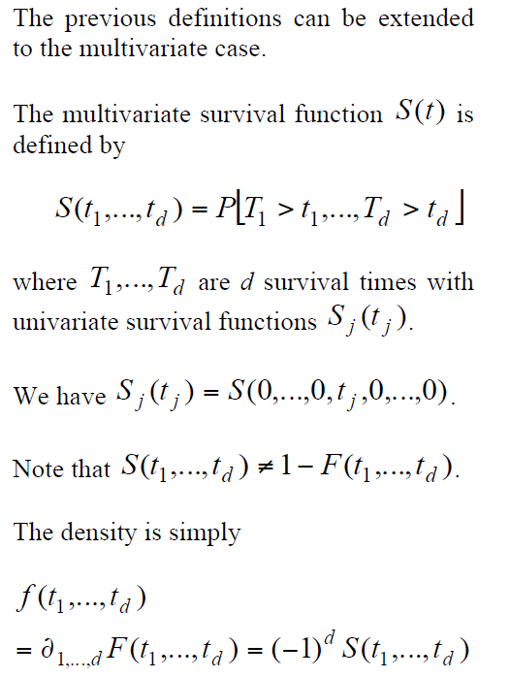
Multivariate survival notions

Slide 11
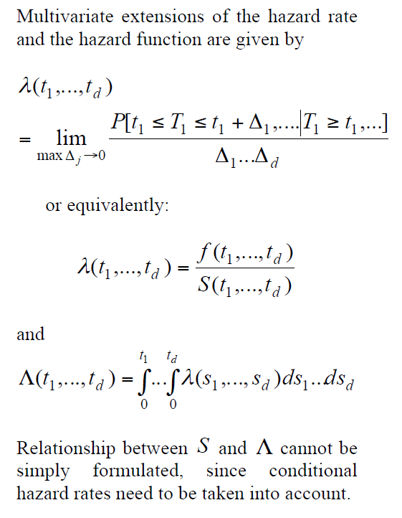
Multivariate survival notions

Slide 12
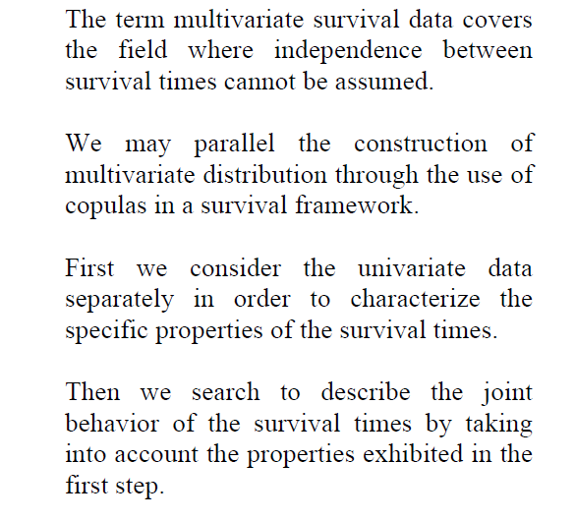
Survival models and copulas

Slide 13
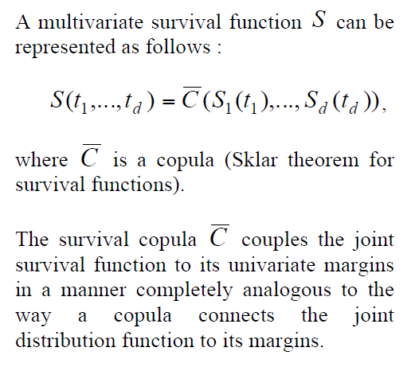
Survival copulas

Slide 14
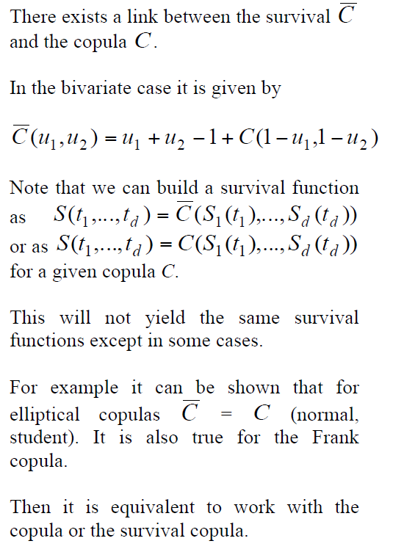
Survival copulas

Slide 15
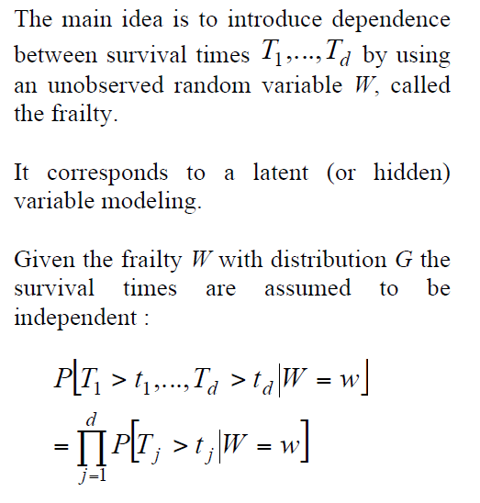
Frailty models

Slide 16
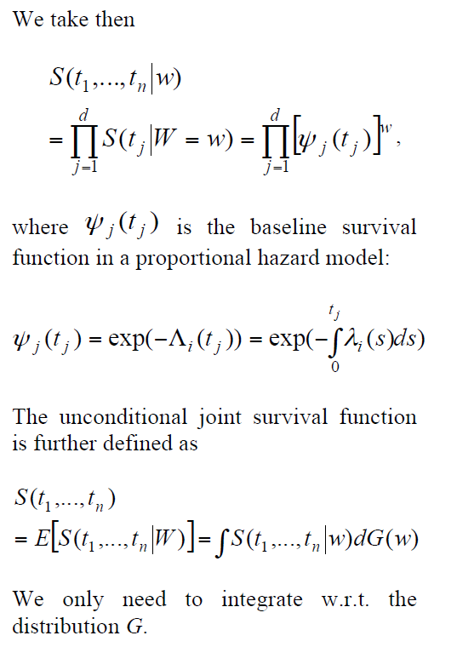
Frailty models

Slide 17
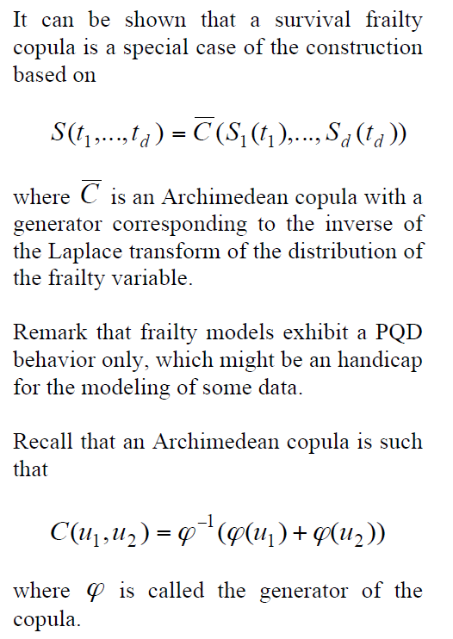
Frailty models

Slide 18
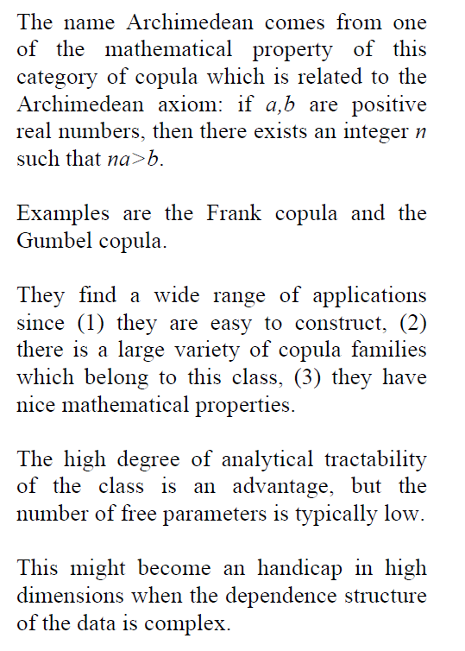
Frailty models

Slide 19
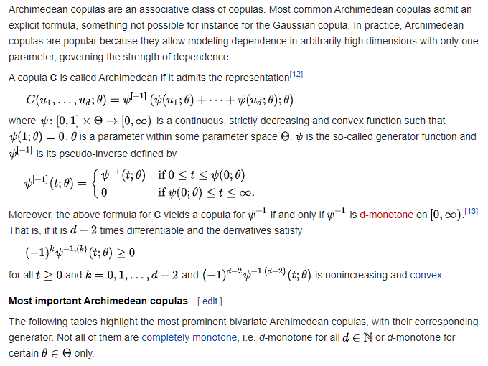
Archimedean copulas
Source: Wikipedia

Slide 20
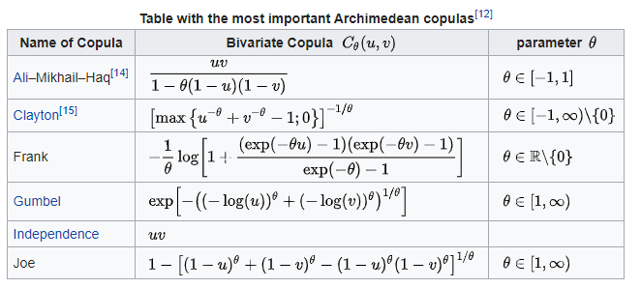
Archimedean copulas
Source: Wikipedia

Slide 21
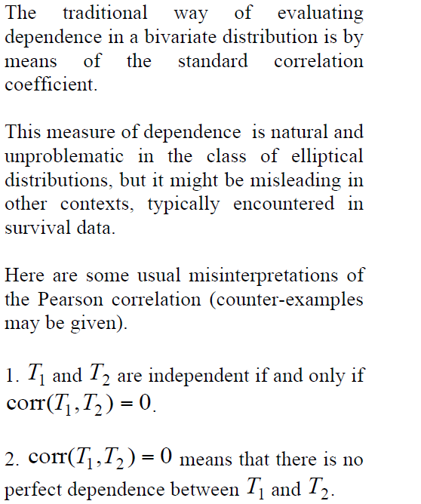
Dependence measures linear correlation

Slide 22
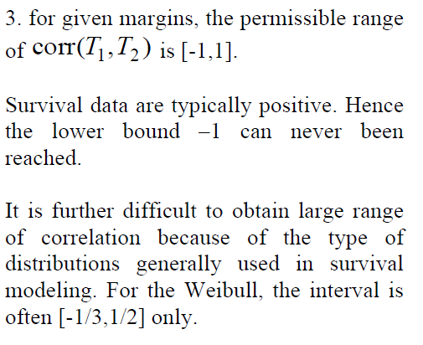
Dependence measures linear correlation

Slide 23
Dependence measures Kendall’s tau and Spearman’s rho

Slide 24
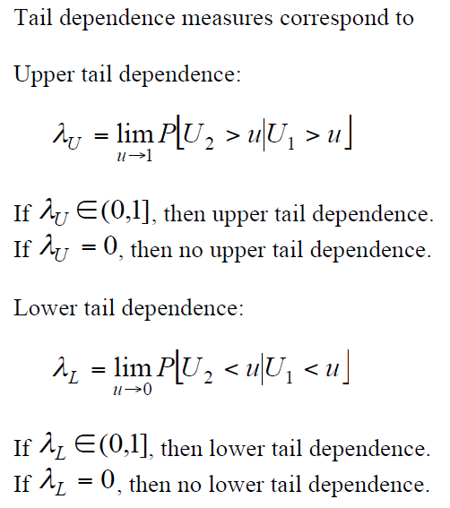
Dependence measures Tail dependence

Slide 25
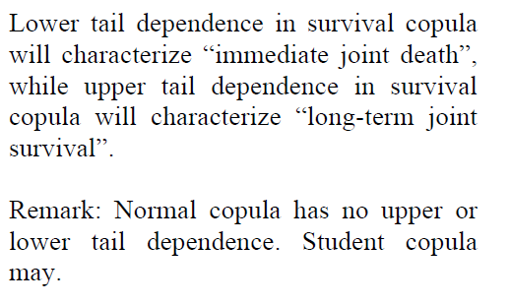
Dependence measures Tail dependence

Slide 26
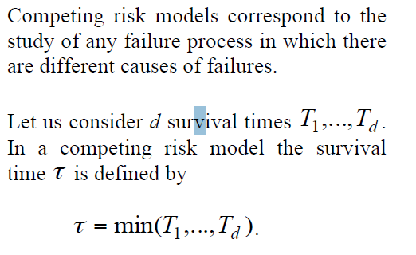
Dependence measures Competing risk models

Slide 27
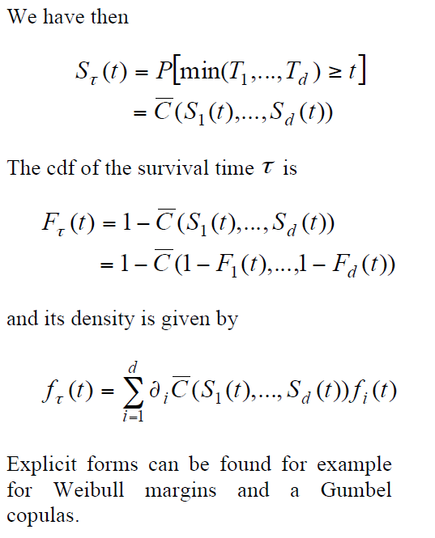
Dependence measures Competing risk models

Slide 28
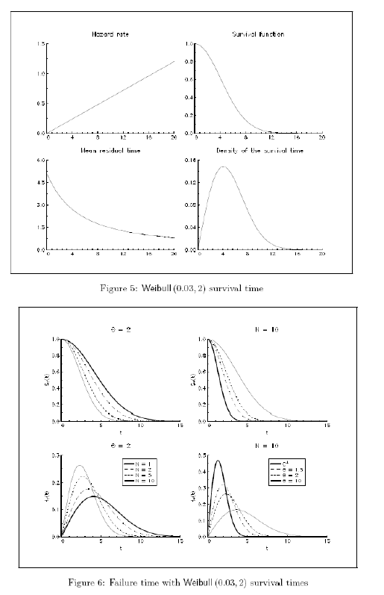
Dependence measures Competing risk models

Slide 29
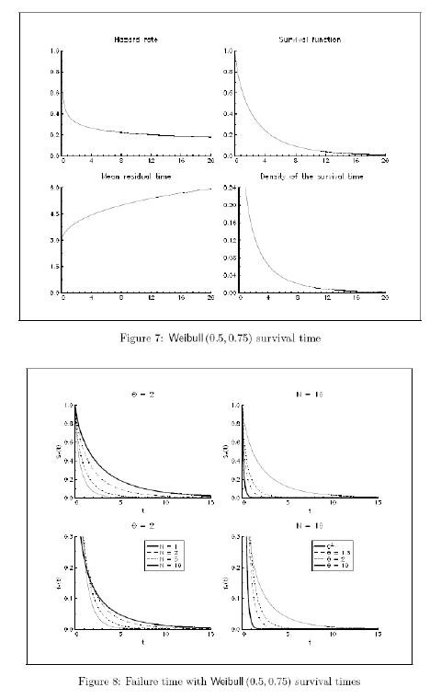
Dependence measures Competing risk models

Slide 30
Dependence measures Competing risk models

Slide 31
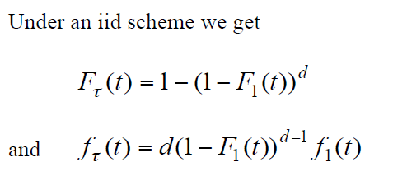
Dependence measures Competing risk models

Slide 32
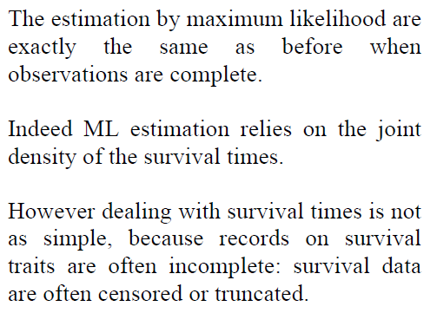
Dependence measures Estimation

Slide 33
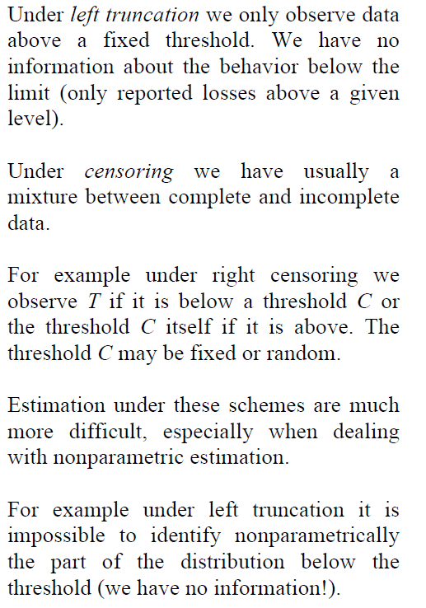
Dependence measures Estimation

Slide 34
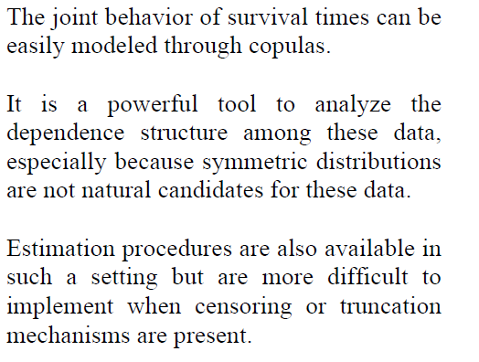
Dependence measures Conclusions

