Slide 1
Quantitative Risk Management GOF
Gilles Criton
2020

Slide 2
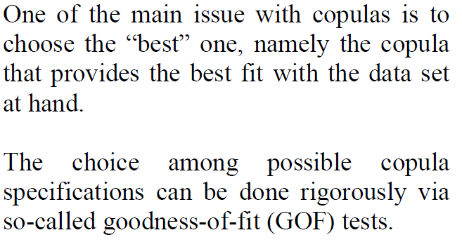
Goodness-of-fit techniques

Slide 3
Goodness-of-fit techniques
Goodness-of-fit techniques can be described as methods of examining how well a sample of data agrees with a given distribution as its population.

Slide 4
Goodness-of-fit techniques: formal framework
Let $X_{1}, X_{2},…,X_{n}$be independent observations from a population with unknown cumulative distribution function (c.d.f.) $F\left(x\right)=F_{0}\left(\left(x−μ\right)/σ\right),$
The problem is then to test the composite hypothesis:
$H_{0}:F\left(x\right)=F_{0}\left(\left(x−μ\right)/σ\right)$,
Where $F_{0}$ is a known continous c.d.f. Against the general alternative
$H_{1}:$ $F\left(x\right)≠F_{0}\left(\left(x−μ\right)/σ\right)$

Slide 5
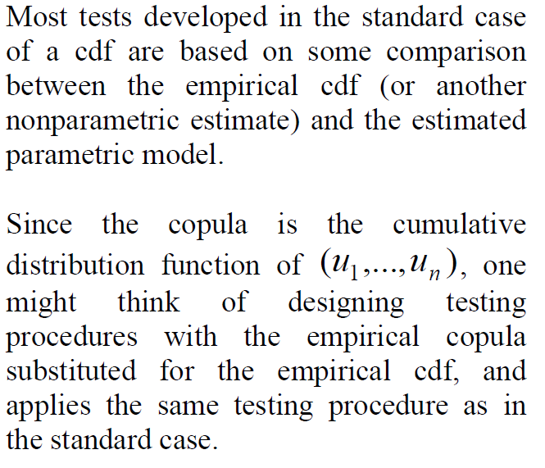
Goodness-of-fit techniques

Slide 6
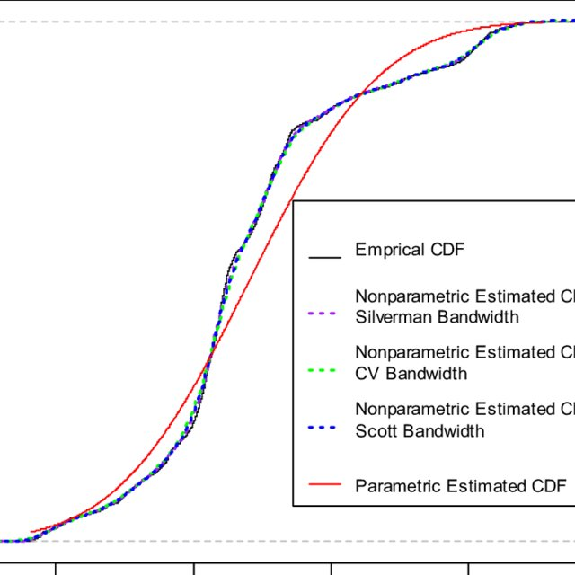
Goodness-of-fit techniques

Slide 7
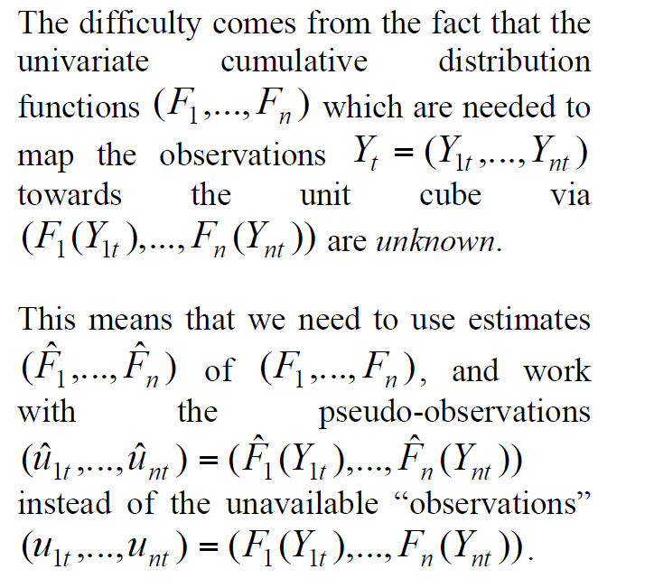
Goodness-of-fit techniques

Slide 8
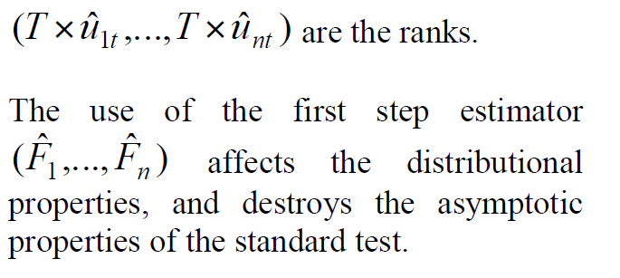
Goodness-of-fit techniques

Slide 9
Goodness-of-fit techniques: Preliminaries
For copula g-o-f testing one is interested in the fit of the copula alone.
The testing is carried out using rank data.
Suppose we have $n$ independent samples $x_{1}=\left(x_{11},…,x_{1d}\right),…,\left(x_{n1},…,x_{nd}\right)$ from the d-dimensional random vector X.
The inference is then based on the so-called pseudo-samples $z_{1}=\left(z_{11},…,z_{1d}\right),…,\left(z_{n1},…,z_{nd}\right)$ from the pseudo-vector Z, where
$$z_{j}=\left(z_{j1},…,z_{jd}\right)=\left(\frac{R_{j1}}{n+1},…,\frac{R_{jd}}{n+1}\right),$$
Where $R_{ji}$ is the rank of $x_{ji}$ amongst $\left(x_{1i},…,x_{ni}\right)$

Slide 10
Goodness-of-fit techniques: Preliminaries
This transformation of each margin through their normalized ranks is often denoted the empirical marginal transformation.
The pseudo-samples $\left(z_{1},…,z_{n}\right)$ can be considered to be samples from the underlying copula C.
However, the rank transformation introduces dependence and $\left(z_{1},…,z_{n}\right)$ are no longer independent samples.

Slide 11
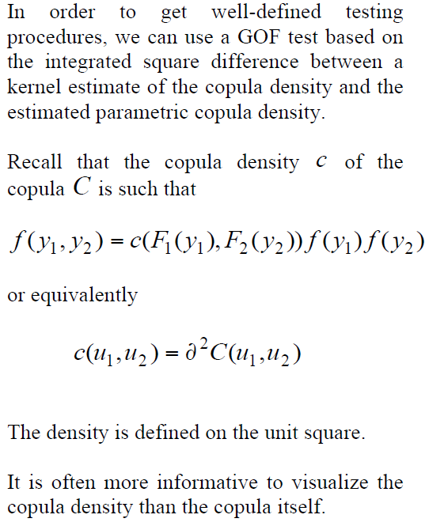
GOF tests

Slide 12
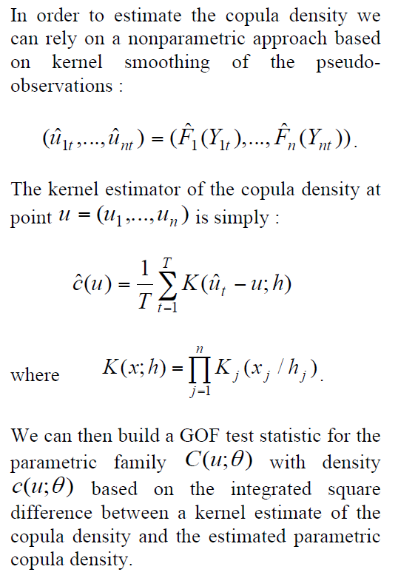
GOF tests

Slide 13
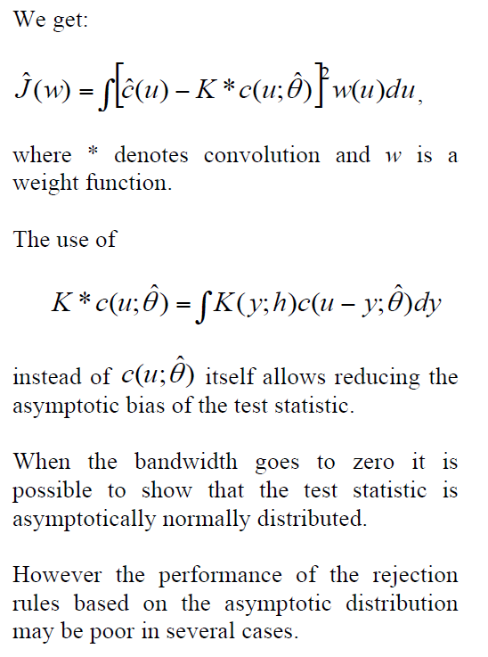
GOF tests

Slide 14
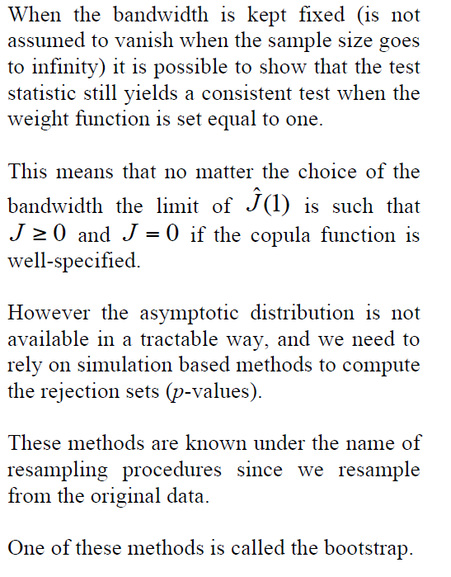
GOF tests

Slide 15
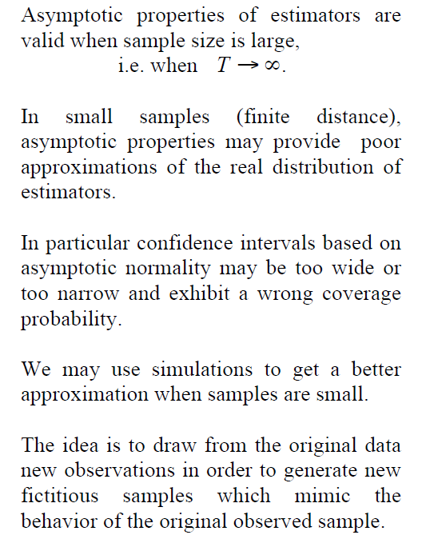
Bootstrap Procedures

Slide 16
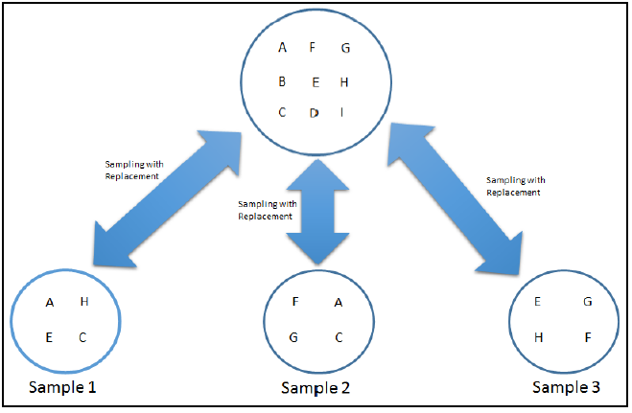
Bootstrap Procedures
Bootstrapping is a statistical technique that’s used to draw an inference about the parameters of population based on the samples drawn from it with replacement and averaging these results out.

Slide 17
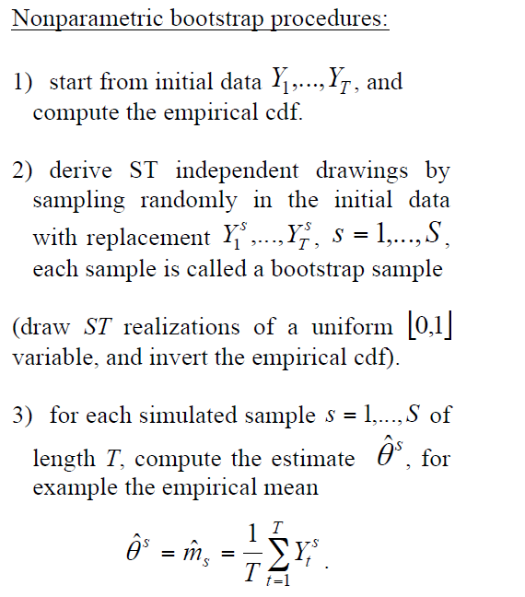
Bootstrap Procedures

Slide 18
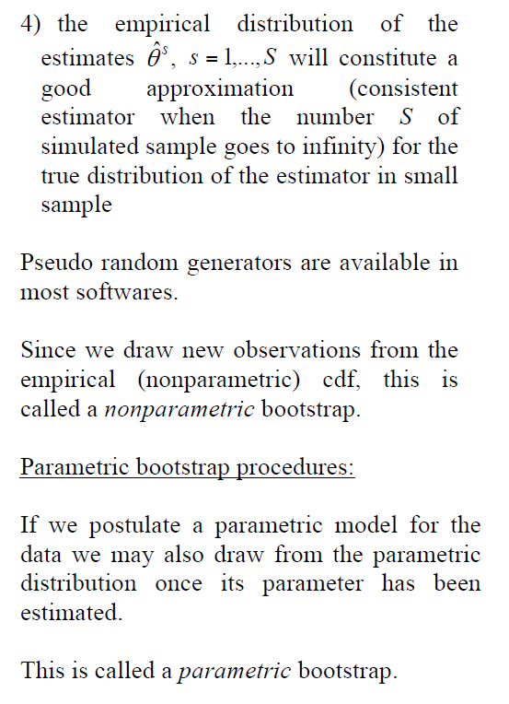
Bootstrap Procedures

Slide 19
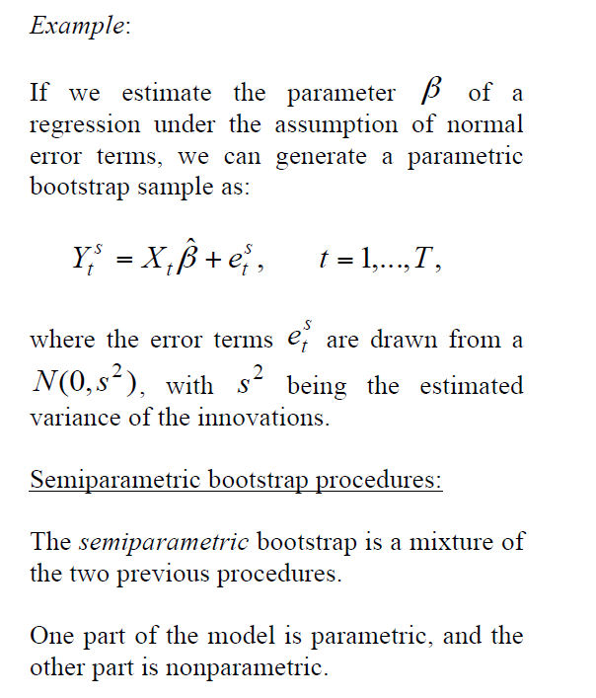
Bootstrap Procedures

Slide 20
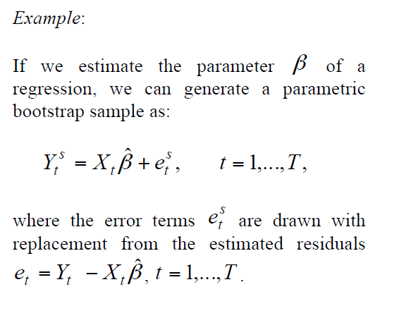
Bootstrap Procedures

Slide 21
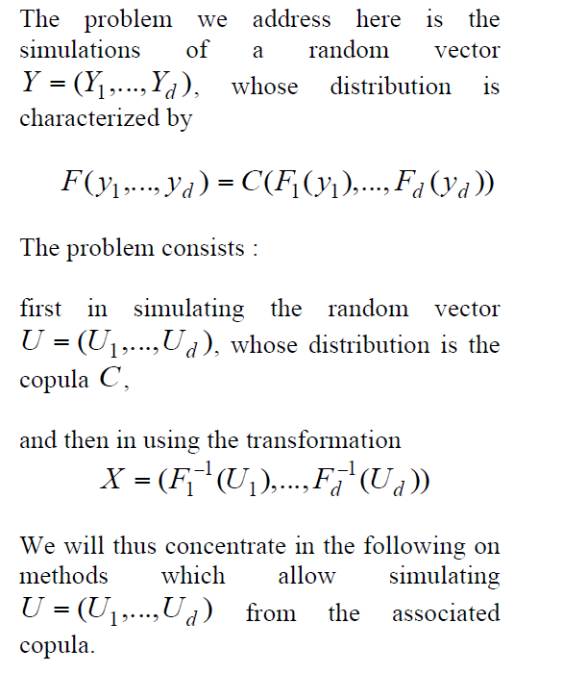
Simulations from Copula models

Slide 22
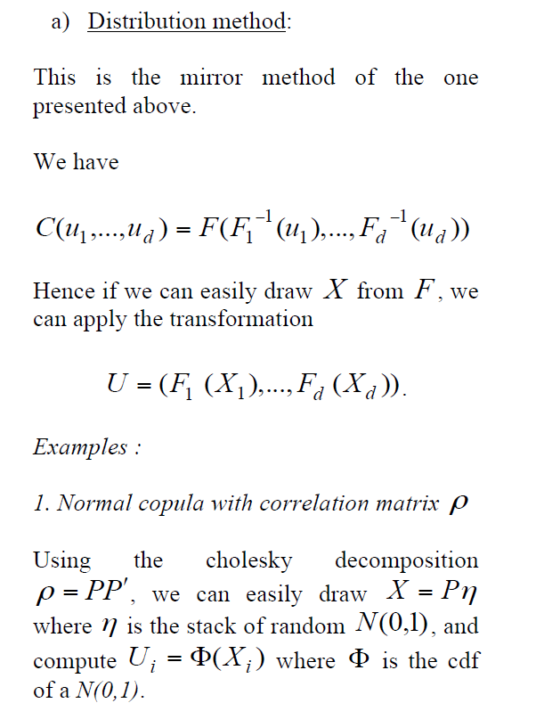
Simulations from Copula models

Slide 23
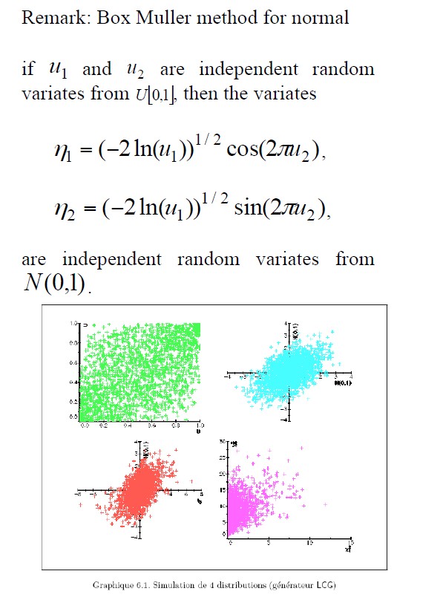
Simulations from Copula models

Slide 24
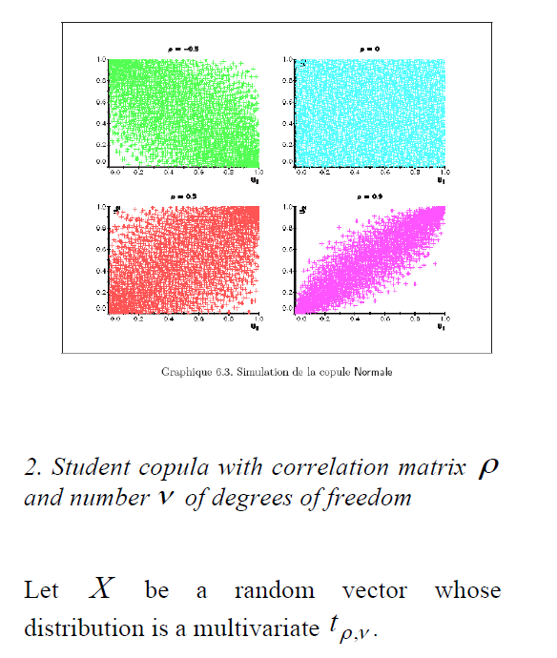
Simulations from Copula models

Slide 25
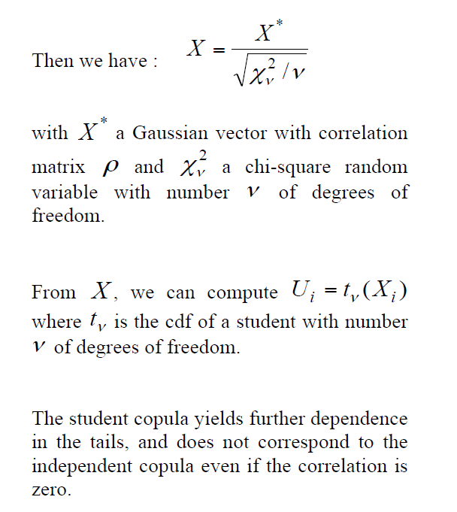
Simulations from Copula models

Slide 26
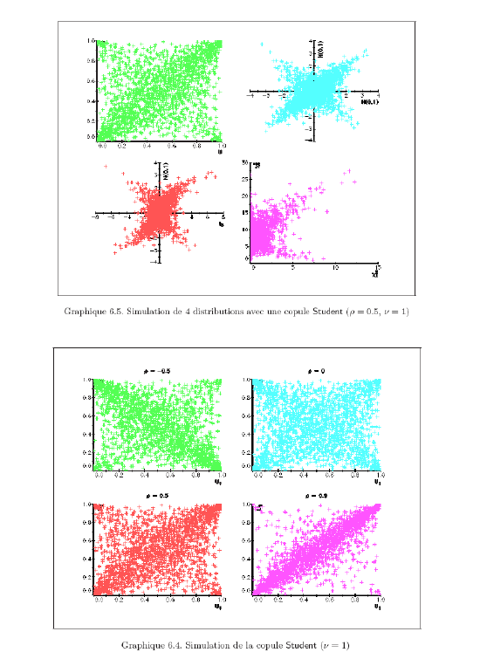
Simulations from Copula models

Slide 27
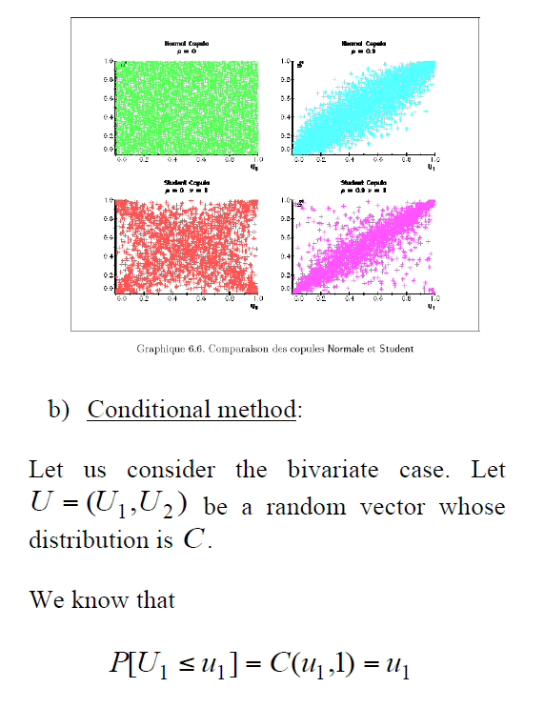
Simulations from Copula models

Slide 28
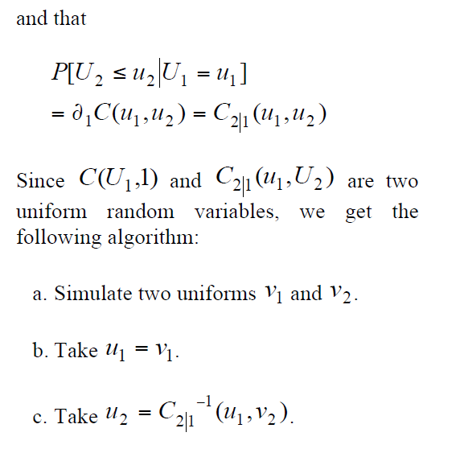
Simulations from Copula models

Slide 29
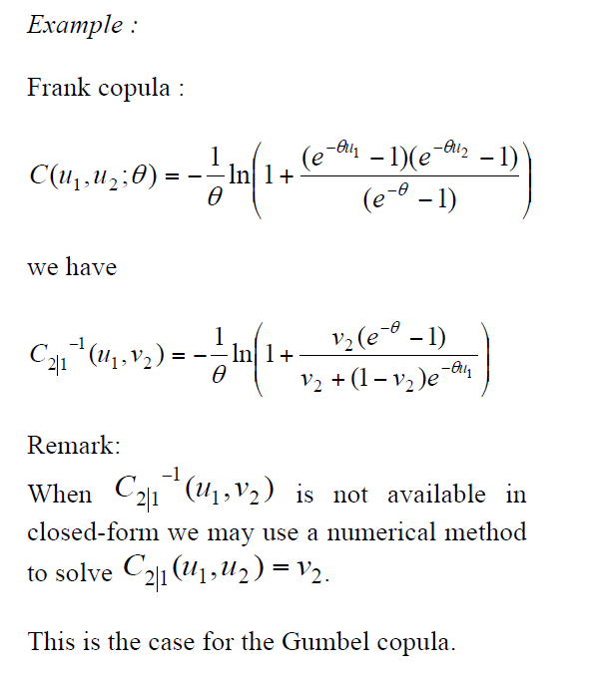
Simulations from Copula models

Slide 30
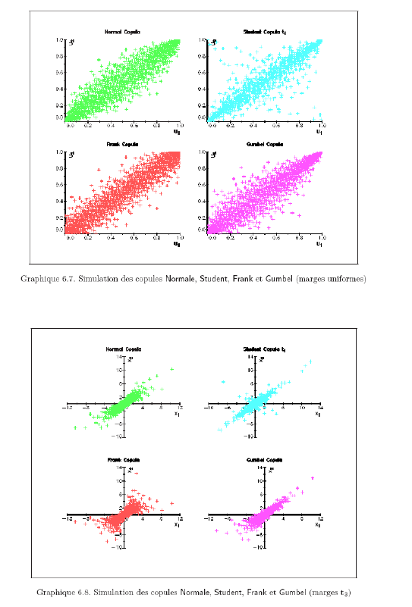
Simulations from Copula models

Slide 31
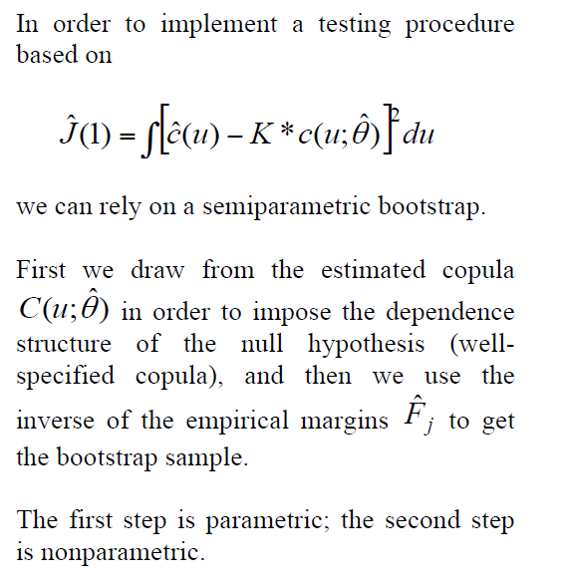
Monte Carlo Results

Slide 32
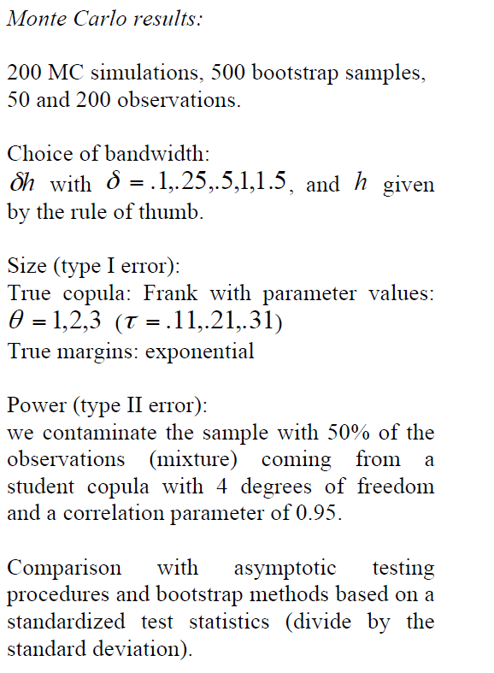
Monte Carlo Results

Slide 33
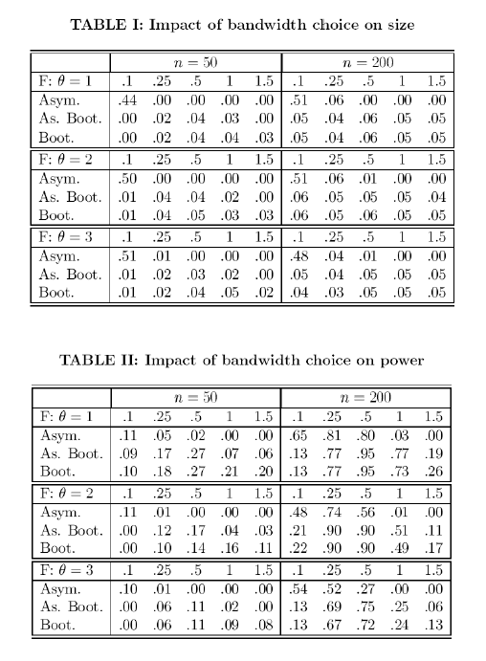
Monte Carlo Results

Slide 34
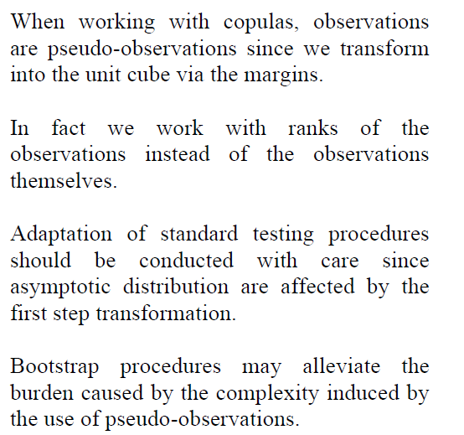
Conclusions

