Slide 1
Quantitative Risk Management
INFERENCE
Gilles Criton
2020

Slide 2

Copulas
The idea behind the copula model is that we do not define the correlation structure between the variables of interest directly ( $t_{i}$), but we map the variables of interest into other more manageable variables ($X_{i}$) and define a correlation structure between those variables.

Slide 3
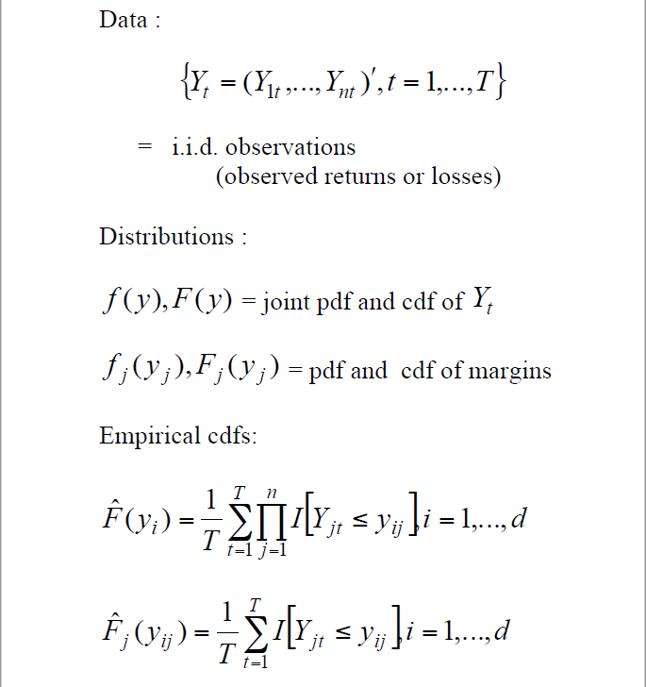
Empirical copulas

Slide 4

Empirical copulas
In practice, the copula C is unknown and its coefficients must be estimated from the data.
Copula estimation is closely related to the estimation of a cumulative distribution function with the main difference that no data from $\left(F\left(X\right), G(Y)\right)$ are observed.

Slide 5
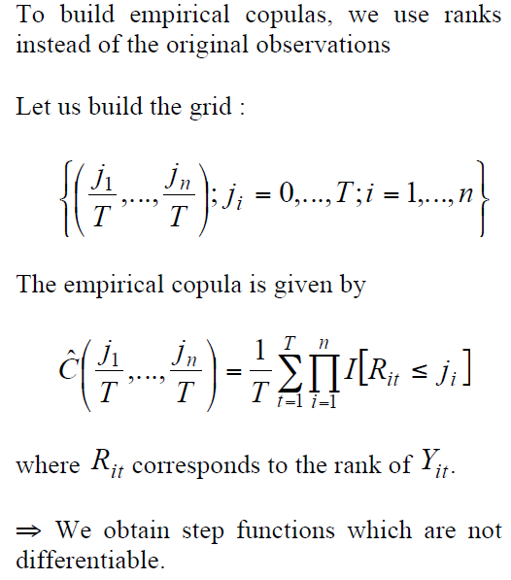
Empirical copulas

Slide 6
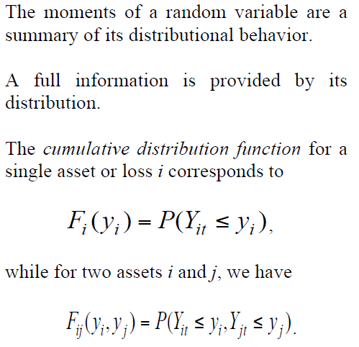
Smoothed copulas
Nonparametric estimation of densities

Slide 7
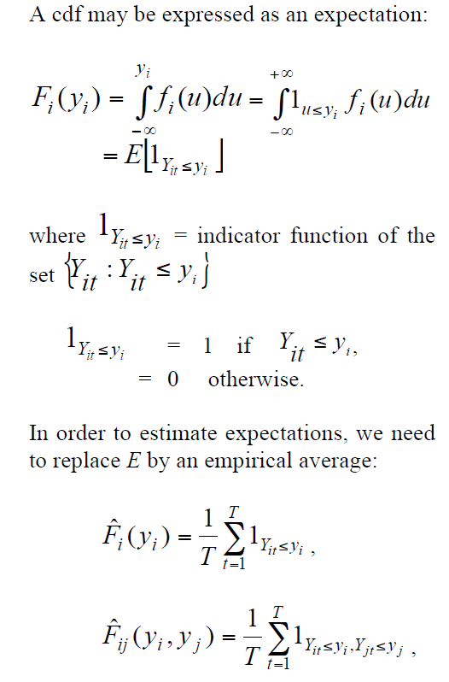
Smoothed copulas
Nonparametric estimation of densities

Slide 8
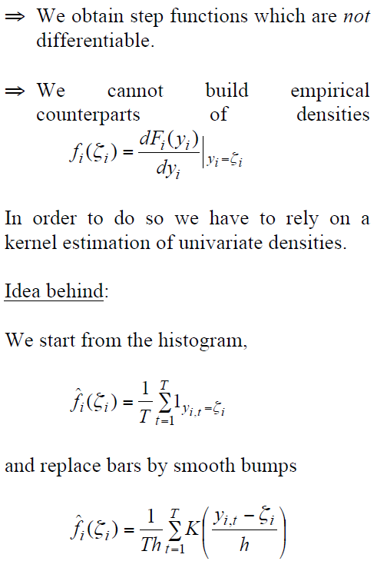
Smoothed copulas
Nonparametric estimation of densities

Slide 9
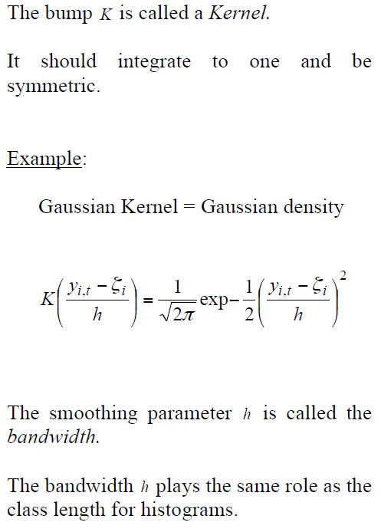
Smoothed copulas
Nonparametric estimation of densities

Slide 10
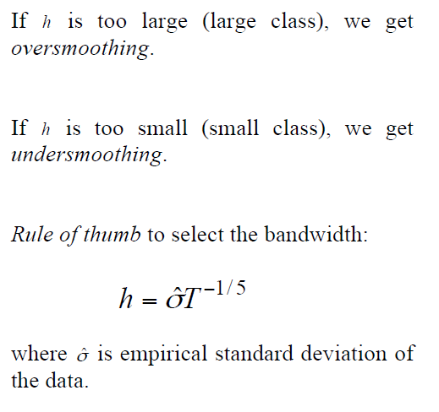
Smoothed copulas
Nonparametric estimation of densities

Slide 11
Smoothed copulas
Nonparametric estimation of densities

Slide 12
Smoothed copulas
Nonparametric estimation of densities

Slide 13
Smoothed copulas
Nonparametric estimation of densities

Slide 14
Smoothed copulas
Nonparametric estimation of densities

Slide 15
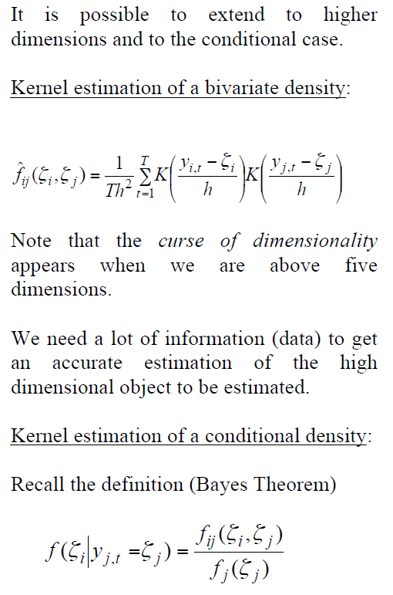
Smoothed copulas
Nonparametric estimation of densities

Slide 16
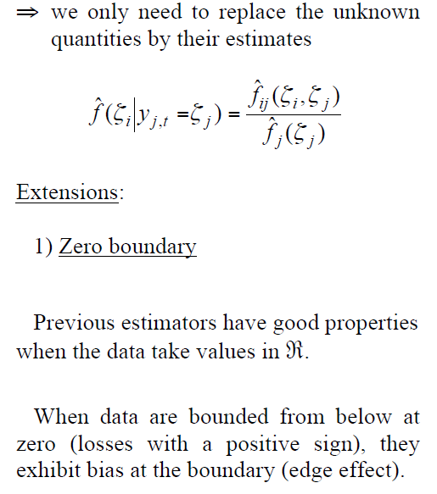
Smoothed copulas
Nonparametric estimation of densities

Slide 17
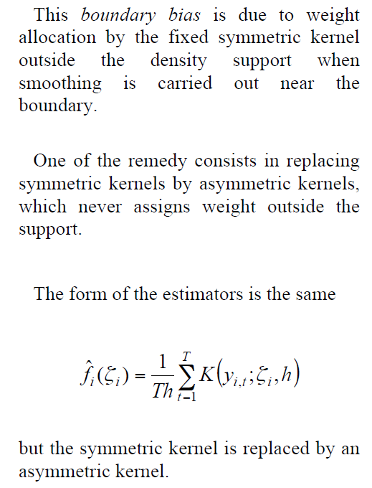
Smoothed copulas
Nonparametric estimation of densities

Slide 18
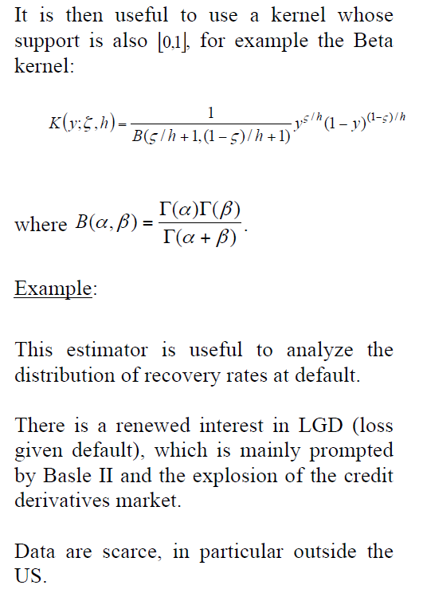
Smoothed copulas
Nonparametric estimation of densities

Slide 19
Estimate LGD
Two main approches can be followed to estimate LGD:
Workout LGD is estimated, based on cash flow recoveries. It relies on ultimate recoveries from the workout process
Market LGD estimations uses the trading prices at some time after default.
The advantages of the workout is that it uses the trues values of recoveries.
The drawbacks of the workout is mainly due to task to compute the LGD from internal recovery cash flows (complex and time-demanding)

Slide 20
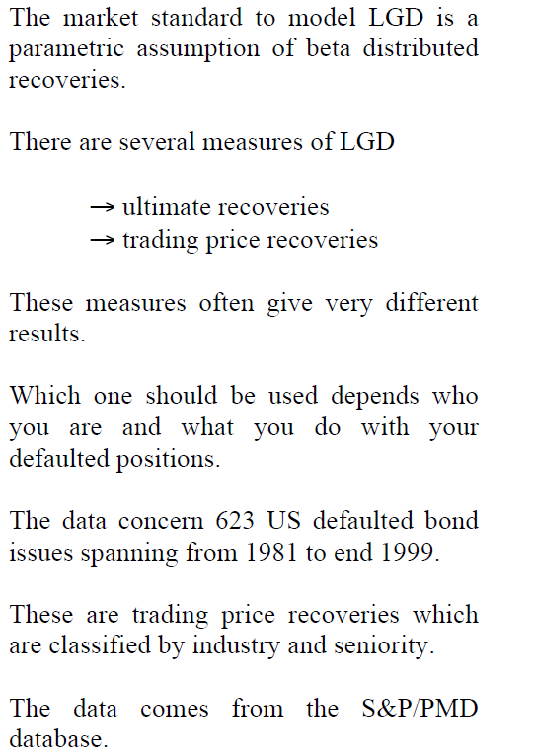
Smoothed copulas
Nonparametric estimation of densities

Slide 21
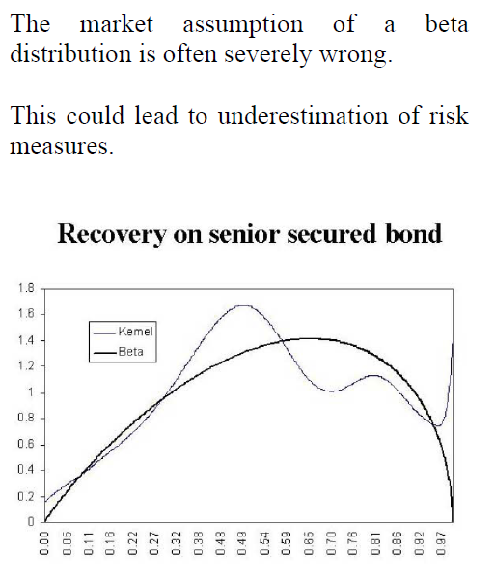
Smoothed copulas
Nonparametric estimation of densities

Slide 22
Smoothed copulas
Nonparametric estimation of densities

Slide 23
Smoothed copulas
Nonparametric estimation of densities

Slide 24
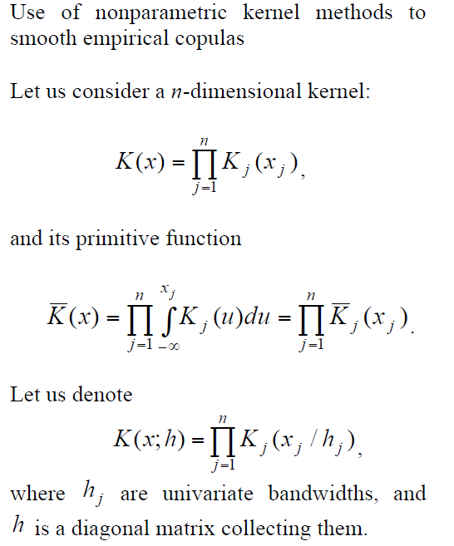
Smoothed copulas
Nonparametric estimation of copulas

Slide 25
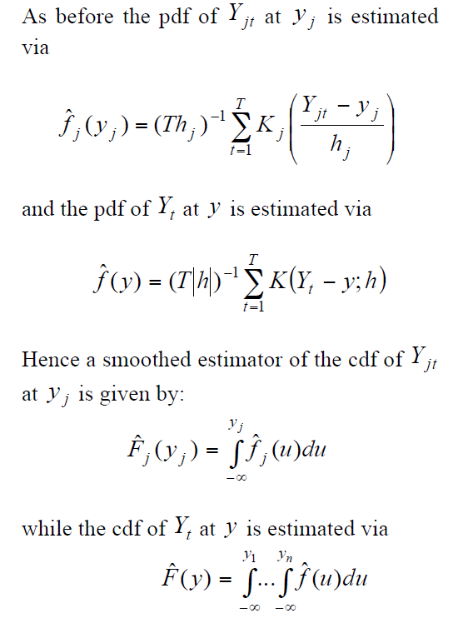
Smoothed copulas
Nonparametric estimation of copulas

Slide 26
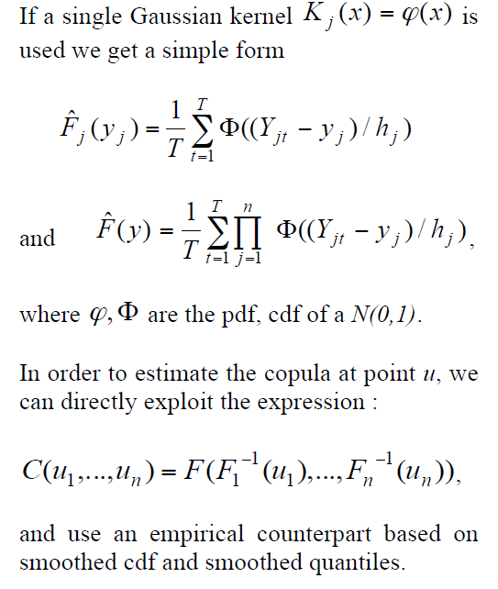
Smoothed copulas
Nonparametric estimation of copulas

Slide 27
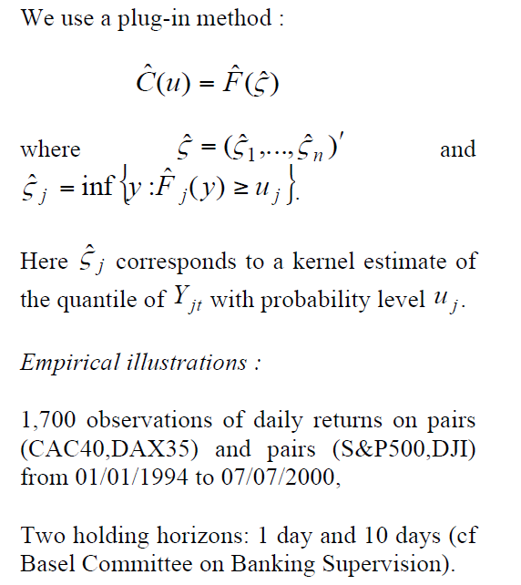
Smoothed copulas
Nonparametric estimation of copulas

Slide 28
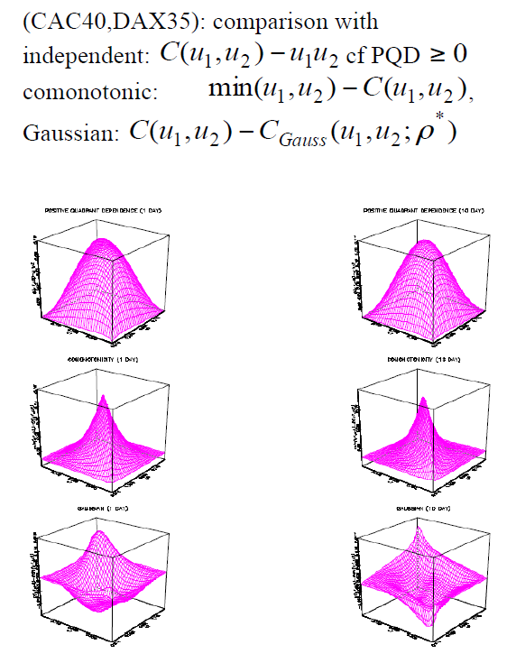
Smoothed copulas
Nonparametric estimation of copulas

Slide 29
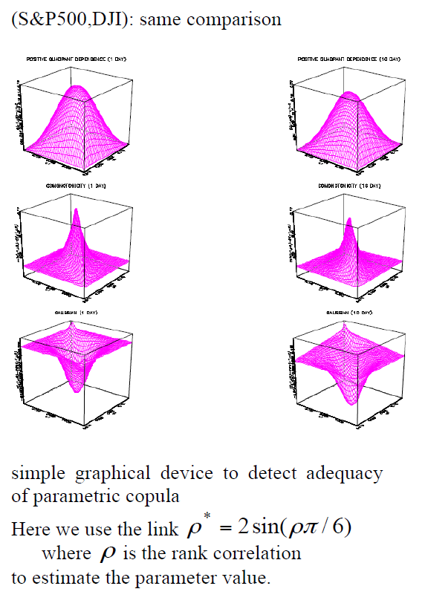
Smoothed copulas
Nonparametric estimation of copulas

Slide 30
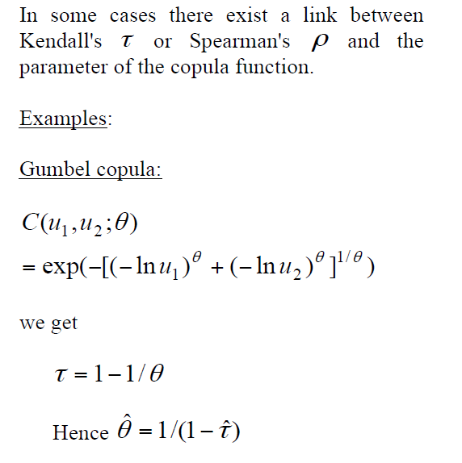
Parametric estimation
Method of moments:

Slide 31
Parametric estimation
Method of moments:

Slide 32
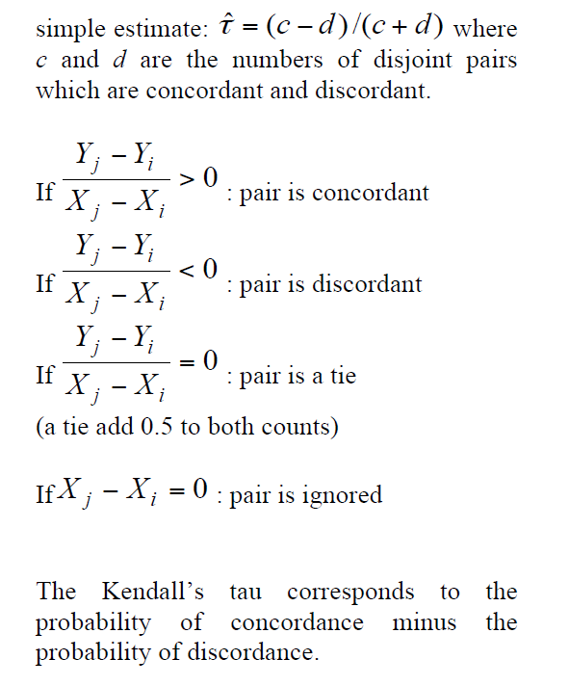
Parametric estimation
Method of moments:

Slide 33
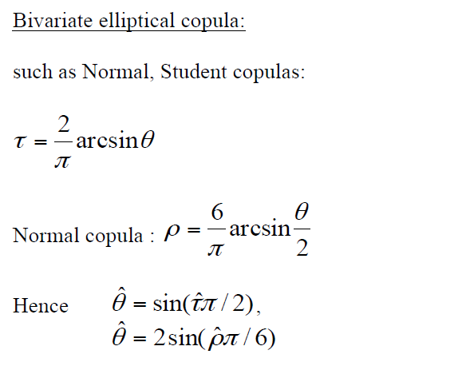
Parametric estimation
Method of moments:

Slide 34
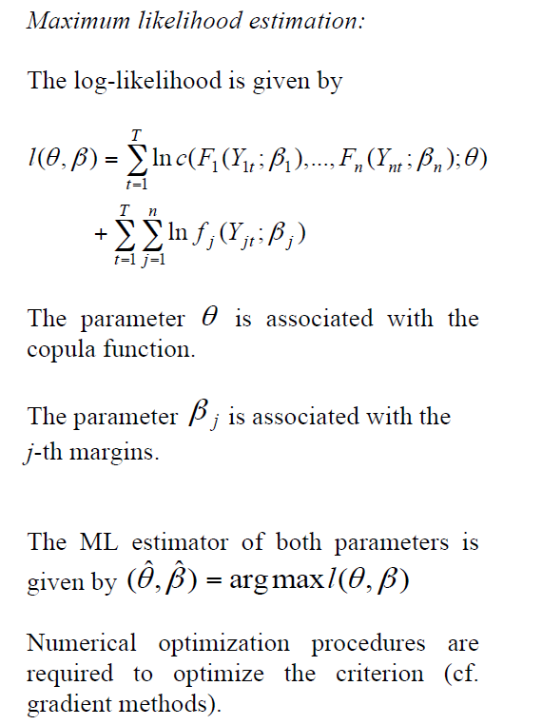
Parametric estimation
Maximum Likelihood Estimation:

Slide 35
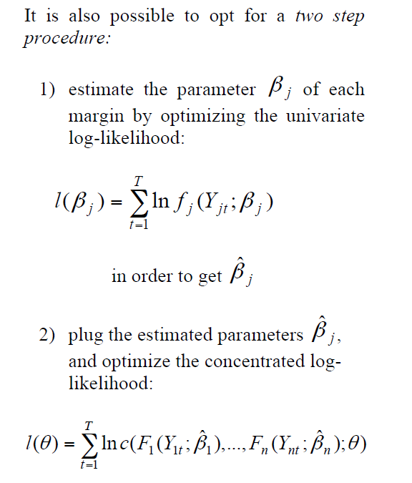
Parametric estimation
Maximum Likelihood Estimation :

Slide 36
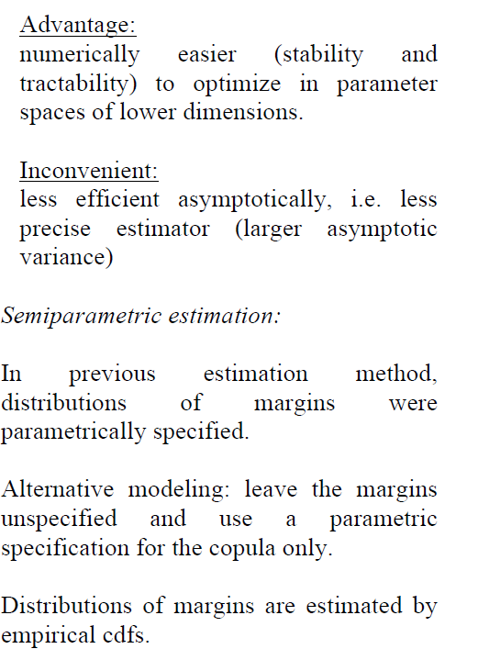
Parametric estimation
Maximum Likelihood Estimation :

Slide 37
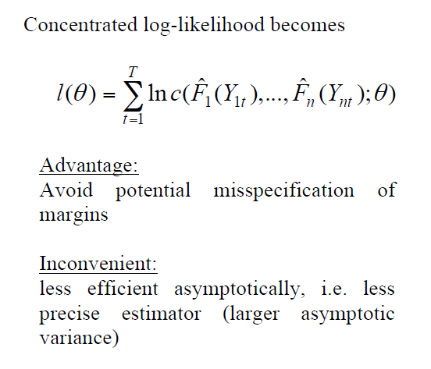
Semi-Parametric estimation

Slide 38
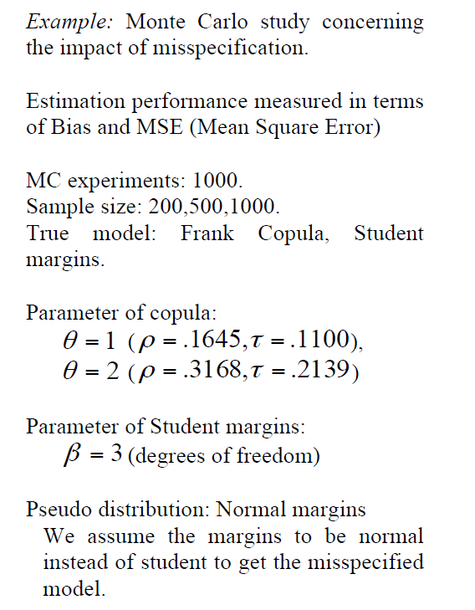
Semi-Parametric estimation
Example:

Slide 39
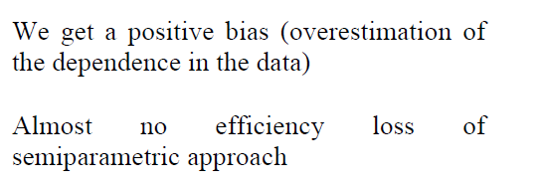
Semi-Parametric estimation
Example:

Slide 40
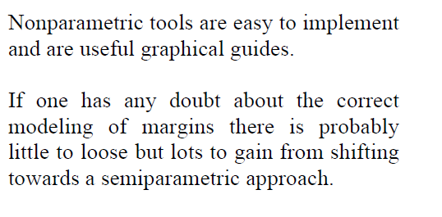
Conclusion

