Slide 1
Quantitative Risk Management PQD
Gilles Criton
2020

Slide 2
Introduction: What is Risk?
A simple definition of risk:
The chance (or probability) of a deviation from an anticipated outcome.
We can attach probabilities to risk. Therefore, it can be measured, estimated or calculated in some way. Risk can therefore be quantified and expressed as a parameter, number or value.
Risk is concerned not just with the extent or probabilities of potential losses but with deviations from the expected outcome.
It is the extent to which the actual result may deviate from the expected result that makes a situation risky.

Slide 3
Introduction: What is Risk?
Risk is a function of objectives:
It is the consequences of the actual result deviating from the expected result that leads to risk.
Without an objective or intended outcome, there is only uncertainty.

Slide 4
Introduction: What is Financial Risk?
The risk is in both the amount involved and its timing.
Impact of changes in the risk factors on the organisation’s accounting numbers…
Financial risk will extend to contingent exposures (expected future transactions).
More general type of financial risk: Economic Exposure.

Slide 5
Introduction: What is Financial Risk
We can define the nature of financial risk to cash flows which leads to three type of risk:
Market risk
Credit Risk
Operational Risk

Slide 6
Introduction: What is Financial Risk
Cargill profits decline 66 per cent
Cargill, the world’s largest agricultural commodity trader, reported a 66 per cent decline in first-quarter profits.
It made a profit of $236 million in the first three months of 2011, compared to $693 million in the first three months of 2010. At the same time, revenues rose by 34 per cent to $34.6 billion, which, when combined with the fall in profits, meant that Cargill suffered a significant reduction in its profit margins.
The company indicated that the significant volatility in financial and commodity markets and in particular its results reflected the ‘stress in financial markets caused by growing economic, fiscal and political concerns on both sides of the Atlantic’ (the US and Europe).

Slide 7
The most used measure for statistical association.
The covariance between two random variables X and Y having finite second moments as
Cov(X, Y ) = σ(X, Y ) = E(X − E(X))(Y − E(Y )).
The Pearson’s ρ, or the product moment correlation, is defined by
ρ = ρ(X, Y ) = $\frac{\text{σ}\text{(}\text{X}\text{, }\text{Y}\text{ ) }}{{\text{σ}}_{X}{\text{σ}}_{Y}}$
The correlation coefficient has been, and probably still is, the most used measure for statistical association.
There are several reasons for this:

Slide 8
The most used measure for statistical association.
It is easy to compute and estimate
Linear models are much used, and in a linear regression model of Y on X, say, is proportional to the slope of the regression line.
In a bivariate Gaussian density
$f\left(x,y\right)=\frac{1}{2π\sqrt{1−ρ^{2}}σ_{X}σ_{Y}}×exp\left\{−\frac{1}{2\left(1−ρ^{2}\right)}\left(\frac{{\left(x−μ_{X}\right)}^{2}}{σ_{X}^{2}}−2ρ\frac{\left(x−μ_{X}\right)\left(y−μ_{y}\right)}{σ_{X}σ_{Y}}+\frac{{\left(x−μ_{Y}\right)}^{2}}{σ_{Y}^{2}}\right)\right\}$
the dependence between X and Y is completely characterized by rho.
In particular, two jointly Gaussian variables (X, Y ) are independent if and only if they are uncorrelated.

Slide 9
The most used measure for statistical association.
The product moment correlation is easily generalized to the multivariate case. For p stochastic variables${ X}_{1},$ ${ X}_{2},…, { X}_{p , }\text{their} \text{joint} \text{dependencies} \text{can} \text{simply}$ be characterized by their covariance matrix
$Ʃ$=$\left\{σ_{ij}\right\}$ with $σ_{ij}$ being the covariance between Xi and Xj
$$f\left(x\right)=\frac{1}{{2π}^{p}{\left|Ʃ\right|}^{1/2}}exp\left\{−\frac{1}{2}{\left(x−μ\right)}^{T}Ʃ^{−1}\left(x−μ\right)\right\}$$
Where $x=\left(x_{1},x_{2},…,x_{p}\right)$
The complete dependence structure of the Gaussian vector is given by the pairwise$σ_{ij}$, or equivalently the pairwise correlations $ρ_{ij}$ .

Slide 10
The most used measure for statistical association.
It is easy to extend the correlation concept to time series.
For a time series {Xt}, the autocovariance and autocorrelation function, respectively, are defined, assuming stationarity and existence of second moments, by $c(t) = σ(X_{t+s} ,{ X}_{s})$and $ρ(t)= ρ(X_{t+s},{ X}_{s})$
For a Gaussian time series, the dependence structure is completely determined by ρ(t)

Slide 11
Weaknesses of Pearson’s rho The non-Gaussianity issue
Heavy tails. The probability distribution of return rt often exhibits heavier tails than those of a normal distribution.
The t-distribution is symmetric and bell-shaped just like a normal distribution. However, it has heavier tails, which means more observations are far from the mean.

Slide 12
Weaknesses of Pearson’s rho The non-Gaussianity issue
if two components of a bivariate t distribution are uncorrelated, they are not necessarily independent.
This pinpoints a serious deficiency of the Pearson’s ρ in measuring dependence in t distributions,

Slide 13
Weaknesses of Pearson’s rho The robustness issue
it is well known that the product moment estimator is sensitive to outliers. Even just one single outlier may be very damaging.
Ex: take 500 observations that have been simulated from the bivariate Gaussian distribution having correlation ρ=-0.5.
The sample value for Pearson’s is $\hat{ρ}=−0.53$.
If we add just three outliers to the data the sample correlation changes to $\hat{ρ}=−0.36$
There are therefore several robustified versions of ρ, primarily based on ranks.

Slide 14
Weaknesses of Pearson’s rho The nonlinearity issue
This is probably the most serious issue with Pearson’s ρ
Example:
$$Y=X^{2}$$
Y is uniquely determined once X is given; i.e., basically the strongest form of dependence one can have
$$E\left(X\right)=E\left(X^{2}\right)=0$$
$$ρ\left(X, Y\right)=0$$

Slide 15
Weaknesses of Pearson’s rho The nonlinearity issue
in ARCH/GARCH time series models:
If $\left\{ε_{t}\right\}$is a time series of zero mean iid variables and if the time series $\left\{h_{t}\right\}$ is independent of $\left\{ε_{t}\right\}$, and $\left\{X_{t}\right\}$ and $\left\{h_{t}\right\}$ are given by the recursive relationship
$X_{t}=ε_{t}h_{t}^{1/2},$ $h_{t}=α+βh_{t−1}+γX_{t−1}^{2}$,
Where the stochastic process $\left\{h_{t}\right\}$ is the so-called volatility process, then the resulting model is a GARCH(1,1)

Slide 16
Weaknesses of Pearson’s rho The nonlinearity issue
The point as far as Pearson’s is concerned, is that $X_{t}$ and $X_{s}$ are uncorrelated for $t≠s$,
but they are in fact strongly dependent through the volatility process $\left\{h_{t}\right\}$, which can be taken to measure financial risk.
This is probably the best known and most important model class where the dependence structure of the process is not at all revealed by the autocorrelation function.
The variables are uncorrelated, but contain a dependence structure that is very important from an economic point of view.

Slide 17
Change of correlation regime during crises
Correlation between stock prices or between indices tends to increase when things go very bad.
On credit correlation derivatives markets, increased a lot during the last crisis: it jumped quite rapidly from levels around 0.4 to levels between 0.95 and 1, and stayed at this unusually high level during several weeks.
Econometricians have long looked for a formal statistical way of describing the shifting region-like dependence structure of financial markets.

Slide 18
Change of correlation regime during crises
It is obvious that when the market is going down there is a stronger dependence between financial objects, and very strong in case of a panic.
Similar effects, but perhaps not quite so strong, appear when the market is going up.

Slide 19
Positive and negative dependence
Dependence structure between asset prices affects risk measures and portfolio selection
Main risk in large portfolios is occurrence of many joint default events or simultaneous downside evolution of prices
What we have seen so far are functionalities that do not distinguish between positive and negative dependence, and they are not local.
Thus not allowing for stronger dependence in multivariate tails as is felt intuitively is the case for data in finance.

Slide 20
PQD
Positive Quadrant Dependence (PQD) describes clustering behavior
Definition :
PQD if probability that two random variables are small is at least as great as it would be were they independent.
$P\left(X≤x,Y≤y\right)≥$ $P\left(X≤x\right)P\left(Y≤y\right)$ for all $\left(x,y\right).$

Slide 21
PQD
It follows immediately from definitions that if (X, Y ) is positively quadrant dependent, then for the Pearson’s $ρ,ρ ≥0$. Similarly, it is that if $F_{X,Y}$ is positively quadrant dependent, then Kendall’s $τ$, Spearman’s $ρ$ are all non-negative.
PQD also allows risk manager to compare the sum of PQD with corresponding sum under independence assumption.
Comparison is in the sense of stochastic orderings.
Thus
Need of testing procedures for presence of PQD

Slide 22
Stochastic orderings
For given random variables X, Y we define the order relation
$X≤_{st}Y, if EF(X)≤Ef(Y)$ for all increasing f.
$X≤_{cx}Y, if EF(X)≤Ef(Y)$ for all convex f.
$X≤_{icx}Y, if EF(X)≤Ef(Y)$ for all increasing convex f.
$X≤_{icv}Y, if EF(X)≤Ef(Y)$ for all increasing concave f.
The ordering $≤_{st}$ is called usual stochastic ordering or first order stochastic dominance (FSD).
In a financial setting it means that any rational decision maker, having an utility function in the sense of von Neumann-Morgenstern, prefers the return Y to the return X.

Slide 23
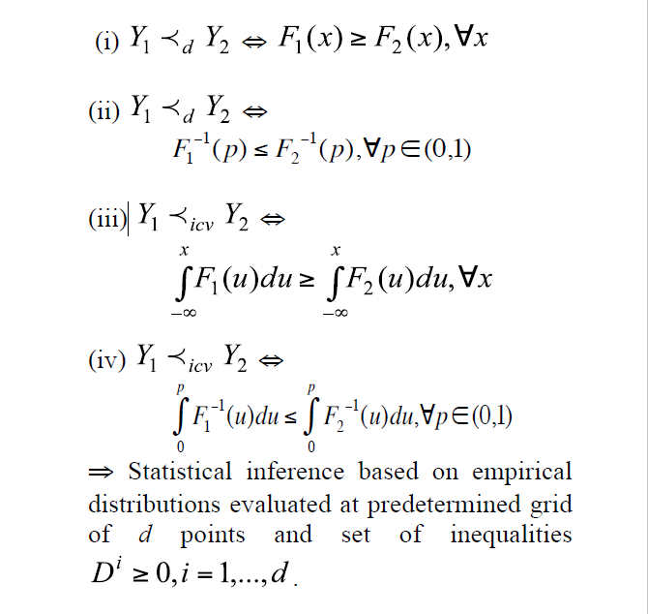
Stochastic orderings
$Y_{2}$ is preferred over $Y_{1}$ by all risk averters
If $Y_{1}≺_{icv}$ $Y_{2}$ and $EY_{1}$=E $Y_{2}$ denoted as $Y_{1}≺_{cv}$ $Y_{2}$
Main characterizations:

Slide 24
Stochastic orderings
$U_{1}$= class of all non-decreasing utilities
$U_{2}$= restriction of to its concave elements
Remarks:
$u^{′}≥0$: increasing (prefer more than less)
$u^{′′}≤0$: concave (risk aversion)
$Y_{1}$ is said to be smaller than $Y_{2}$
In the stochastic dominance order
If $Eu(Y_{1})≤Eu(Y_{2})$ for $u∈U_{1}$
In the increasing concave order
If $Eu(Y_{1})≤Eu(Y_{2})$ for $u∈U_{2}$

Slide 25
Detecting nonlinear and non-Gaussian Structures
For two variables, why not taking the joint density function $f\left(x,y\right)$
Or the cumulative distribution function $F\left(x,y\right)$
If a parametric density model is considered, it is difficult to give an interpretation of the parameters in terms of the strength of the dependence.
If we look at non parametric estimates for multivariate density functions... The problems increase with dimension due both to difficulties of producing a graphical display and to the lack of precision of the estimates due to the curse of dimensionality

Slide 26
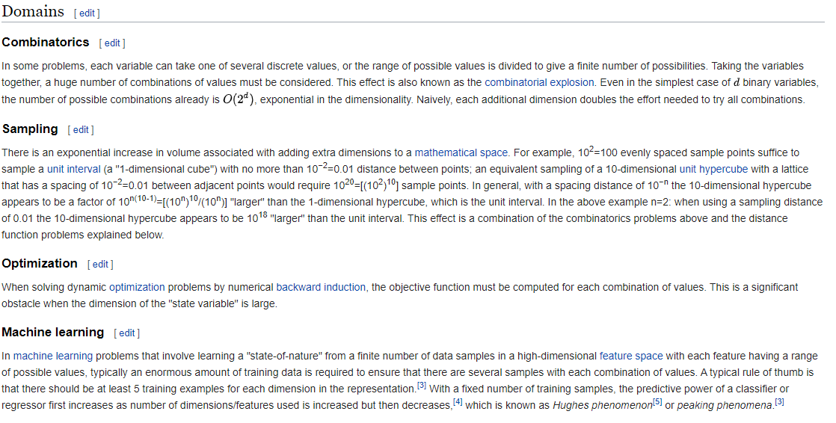
Curse of dimensionality
From wikipedia

Slide 27
Detecting nonlinear and non-Gaussian Structures
Another problem in analyzing a joint density function is that it may be difficult to disentangle effects due to the shape of marginal distributions and effects due to dependence among the variables involved.
This last problem is resolved by the copula construction.
Sklar’s (1959) theorem states that a multivariate cumulative distribution function F(x) = F($x_{1}$, . . . , $x_{p}$) with marginals $F_{i}$($x_{i}$), i = 1, . . . , p can be decomposed as
F($x_{1}$, . . . , $x_{p}$) = C($F_{1}$($x_{1}$). . . , $F_{p}$($x_{p}$))
where C($u_{1}$, . . . $u_{p}$) is a distribution function over the unit cube ${\text{[0}\text{, }\text{1]}}^{p}$.

Slide 28
Sklar's representation

Slide 29
Sklar's Theorem

Slide 30
Sklar's Theorem

Slide 31
Links with dependence measures

Slide 32
Positive quadrant dependence
Tests of independence (rank correlation, Kendall’s t-statistic) are designed to detect specific types of alternatives i.e. those for small values of Y tend to be associated with small values of X (positive dependence) and vice versa.
Positive Quadrant Dependence (PQD) is a specific type of dependence between random variables.
$P\left(X≤x,Y≤y\right)≥$ $P\left(X≤x\right)$ $P\left(Y≤y\right)$
PQD if probability that two random variables are small is at least as great as it would be were they independent

Slide 33
Positive quadrant dependence
In term of copulas:
$$C\left(u_{1},u_{2}\right)≥u_{1}u_{2}$$

Slide 34
Positive orthant dependence
a d-dimensional copula C is a multivariate distribution function C :
$I^{d}→I$ defined for every $u=\left(u_{1},…,u_{d}\right)∈$ $I^{d}$as
$C\left(u\right)$=$p\left(U≤u\right)$=$p\left(U_{1}≤u_{1},…,U_{d}≤u_{d}\right)$
X is positively lower orthant dependent (PLOD) if
$P\left(X_{1}≤x_{1},…,X_{d}≤x_{d}\right)≥$ $P\left(X_{1}≤x_{1}\right)$… $P\left(X_{d}≤x_{d}\right)$
In term of copulas,
$C\left(u_{1},…,u_{d}\right)≥u_{1}$... $u_{d}$

Slide 35
Positive orthant dependence
X is positively upper orthant dependent (PUOD) if
$P\left(X_{1}>x_{1},…,X_{d}>x_{d}\right)≥$ $P\left(X_{1}>x_{1}\right)$… $P\left(X_{d}>x_{d}\right)$
That is, if the probability that the variables $X_{1} ,…,X_{d}$are simultaneously large is at least as great as it would be were they independent.
X is positively orthant dependent (POD) if both inequalities hold.

Slide 36
Positive orthant dependence
In term of copulas:
$$C\left(u_{1},…,u_{d}\right)≥u_{1},…,u_{d}$$

Slide 37
Applications of dependence notions

Slide 38
Applications of dependence notions
«…A better knowledge of the dependence between financial assets or claims is crucial to assess the risk of clustering. This clustering behavior can be described by a useful concept known as PQD...»
«…It allows the risk manager to directly compare the sum of PQD random variables with the corresponding sum under the independence assumption…»
«…Inferring that two claims are PQD, regardless of the strength of this dependence, immediately allows us to infer the underestimation of most insurance premiums…»

Slide 39
Positive quadrant dependence example

Slide 40
Lorenz Order
The Lorenz order is a natural tool for comparison of the variability of non negative random variables.
In many contexts (especially reliability) variability comparison of order statistics is of interest.

Slide 41
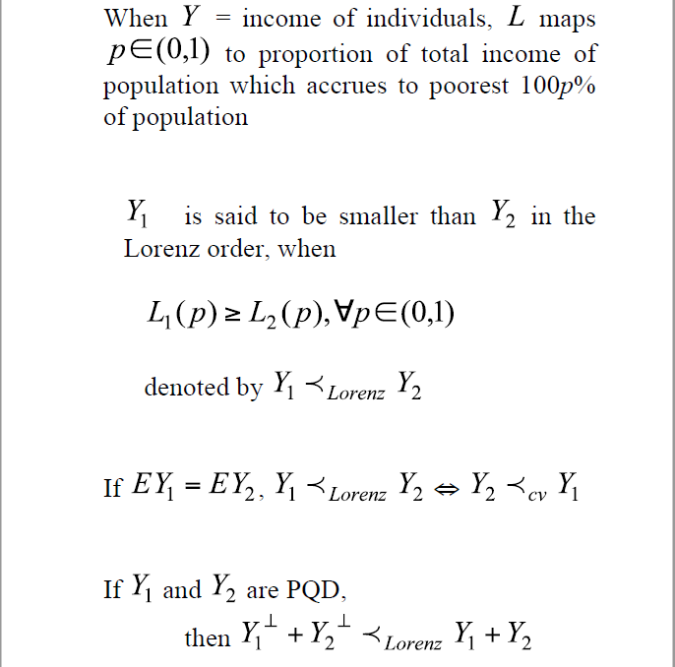
Positive quadrant dependence example

Slide 42
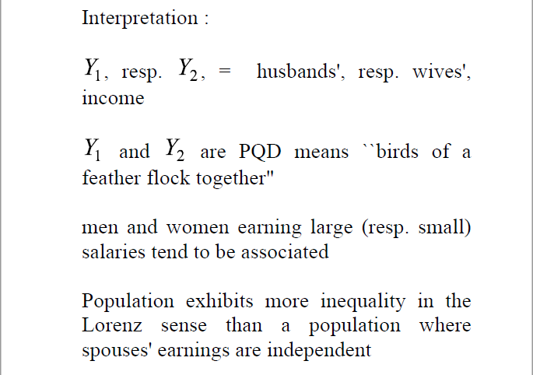
Positive quadrant dependence example

Slide 43
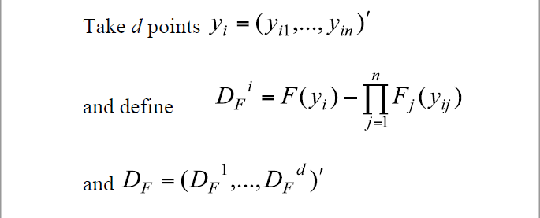
Hypotheses testing Inference based on cdfs

Slide 44
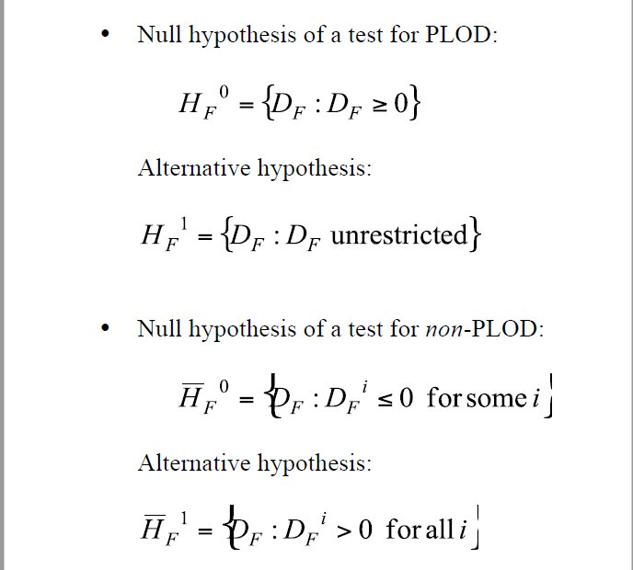
Hypotheses testing Inference based on cdfs

Slide 45
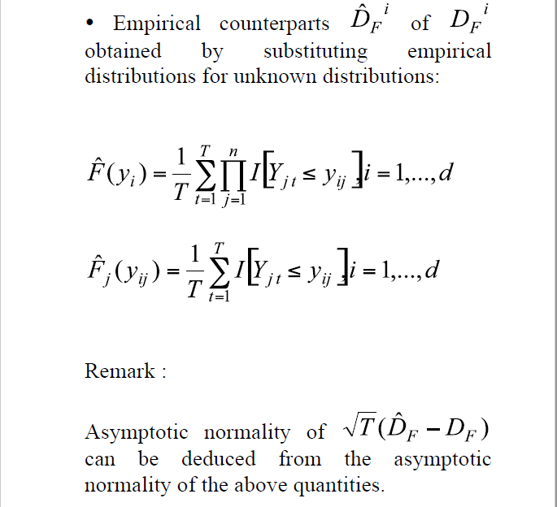
Hypotheses testing Inference based on cdfs

Slide 46
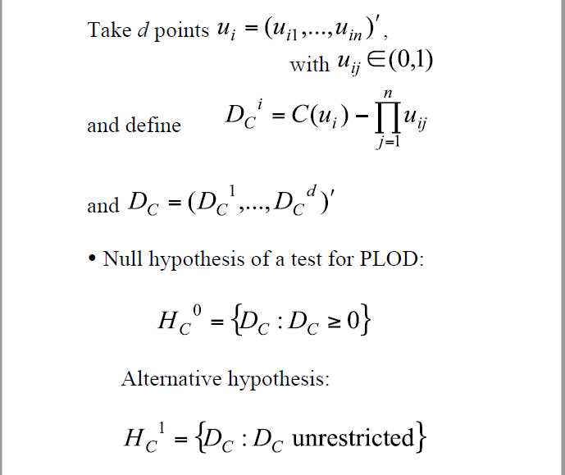
Hypotheses testing Inference based on copulas

Slide 47
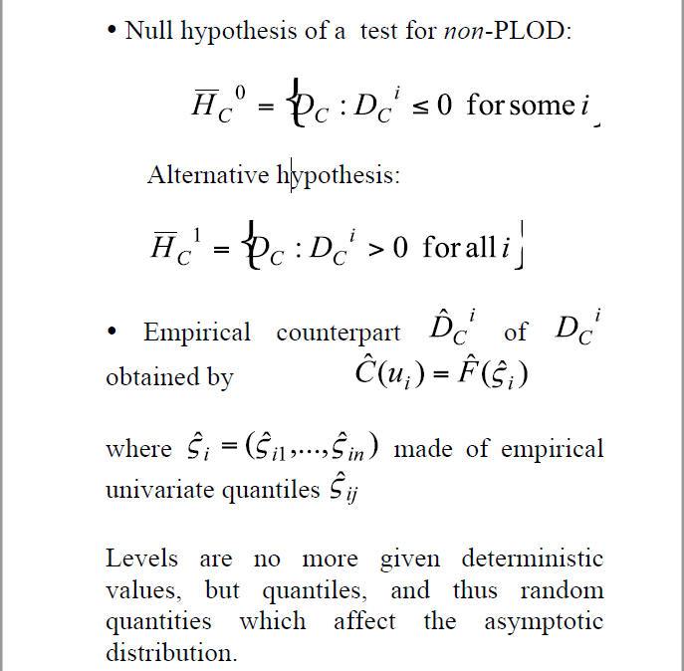
Hypotheses testing Inference based on copulas

Slide 48
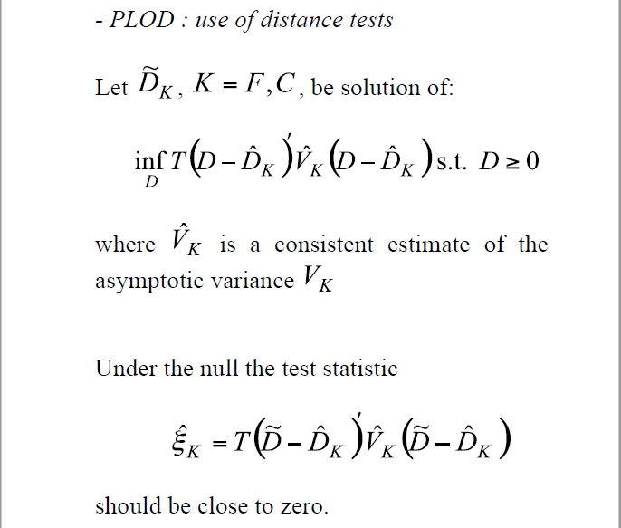
Testing procedures

Slide 49
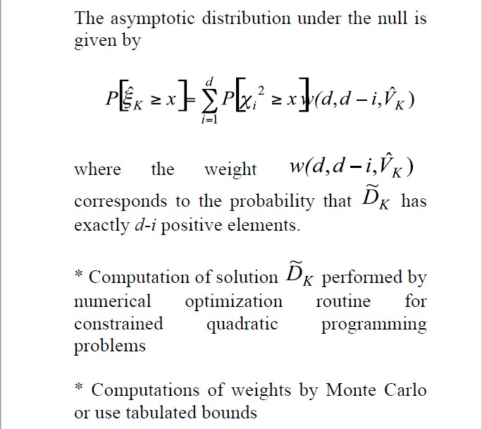
Testing procedures

Slide 50
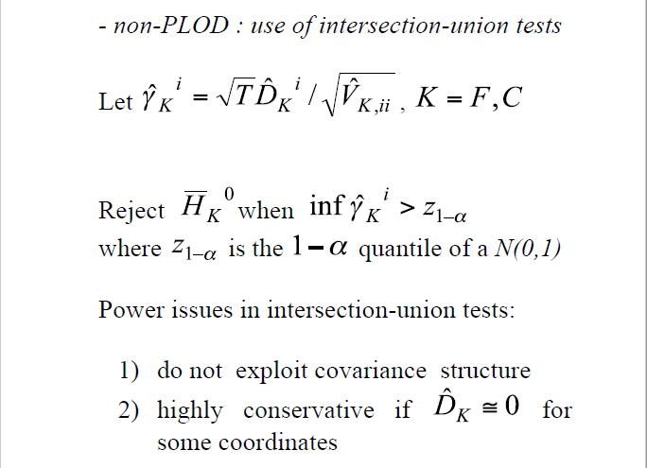
Testing procedures

